Slide 1
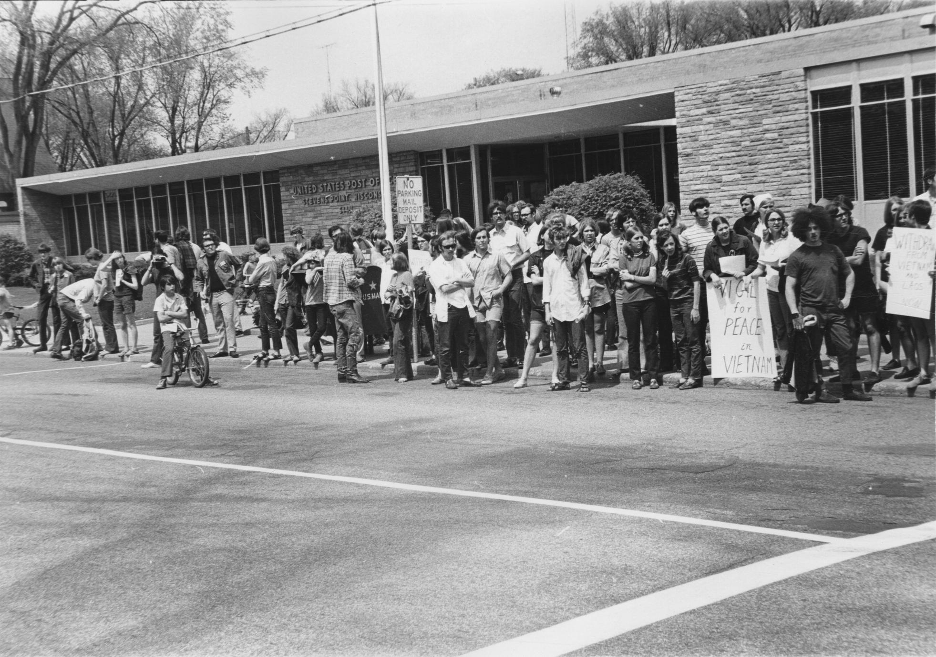
-Vietnam War protests at UWSP-
Why were people protesting the Vietnam war at UWSP?
Notes:
Use headphones and turn off fan or go someware quiet

Slide 2
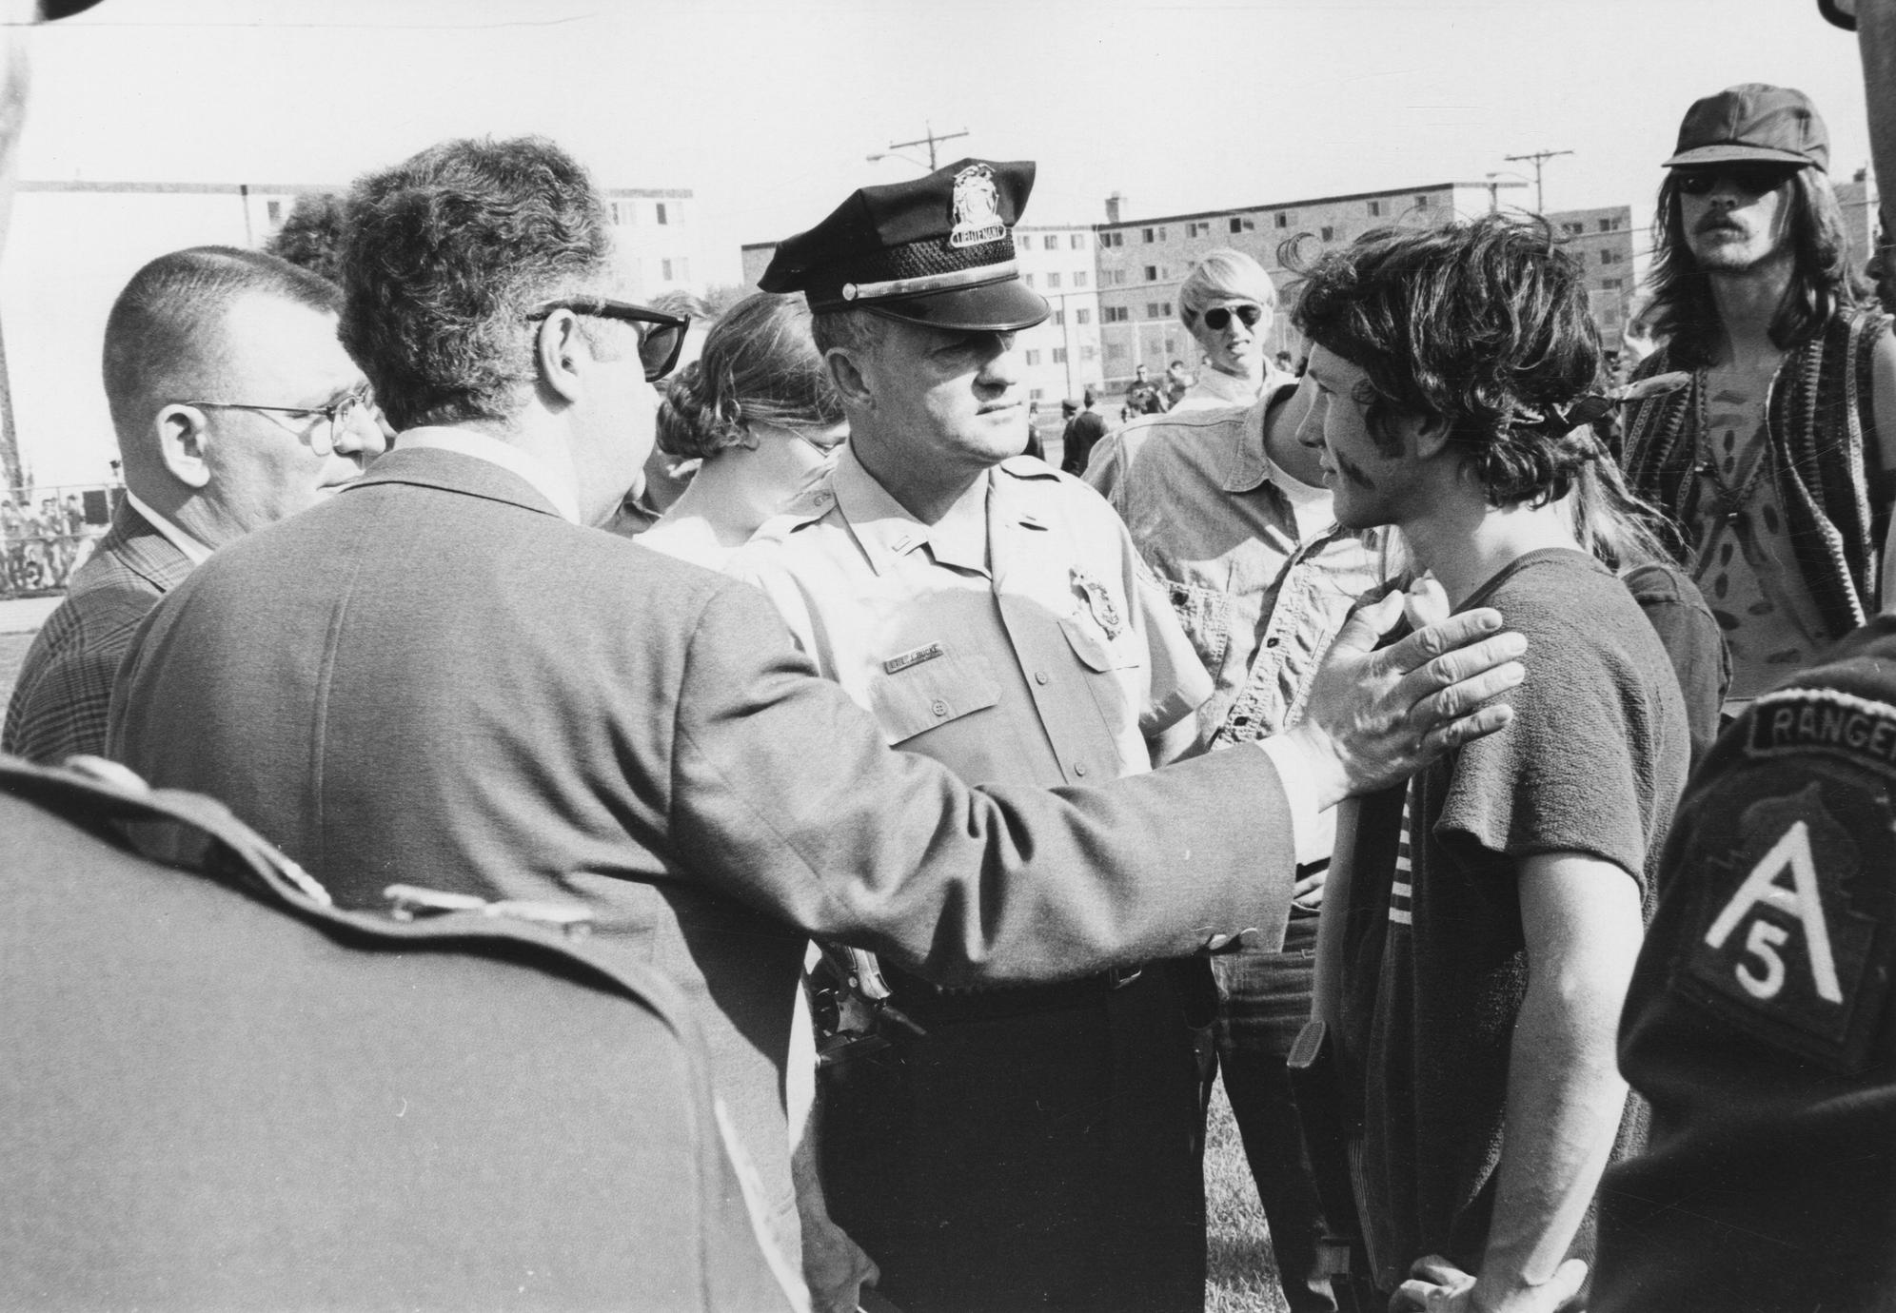
Lecture outline:
Who am I? Why this topic?
What can images tell us?
What is The Vietnam War?
Why were people protesting it?
Why were college students protesting it?
What's was going on at UWSP?
The Counterpoint newspaper**
My sources and research.

Slide 3
Why this topic and who am I?
Who am I:
Collage student in a history of the public class at UWSP(University of Wisconsin Stevens Point).
For our final in the class we needed to create a public history research project of a topic related to our own local history or UWSP history.
Why this topic:
This all started with pictures I found of Vietnam War protests in a digital photo archive.
They made me think of lots of questions. The main one being, why were people protesting The Vietnam War at UWSP?
Some of the images that started this project…

Slide 4
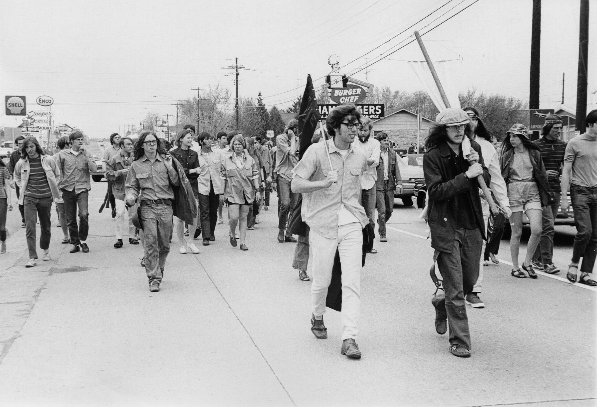
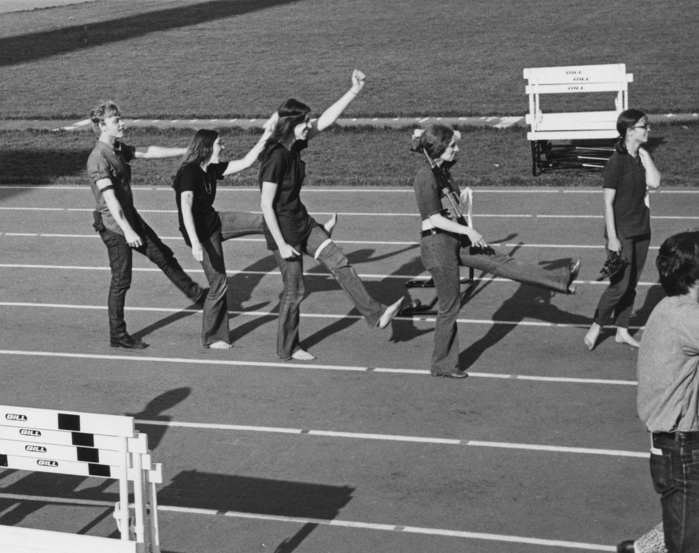
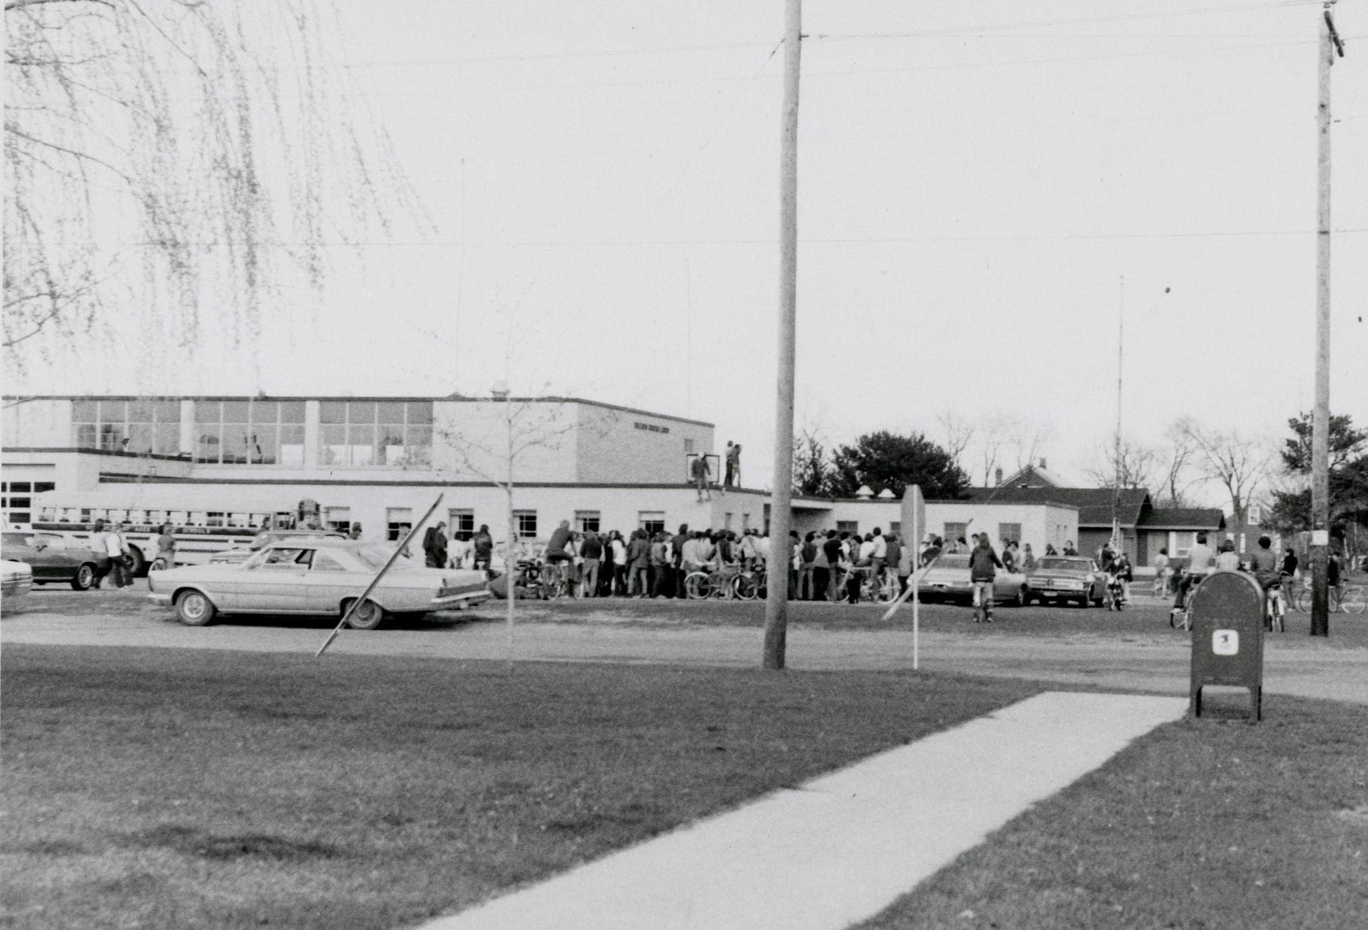
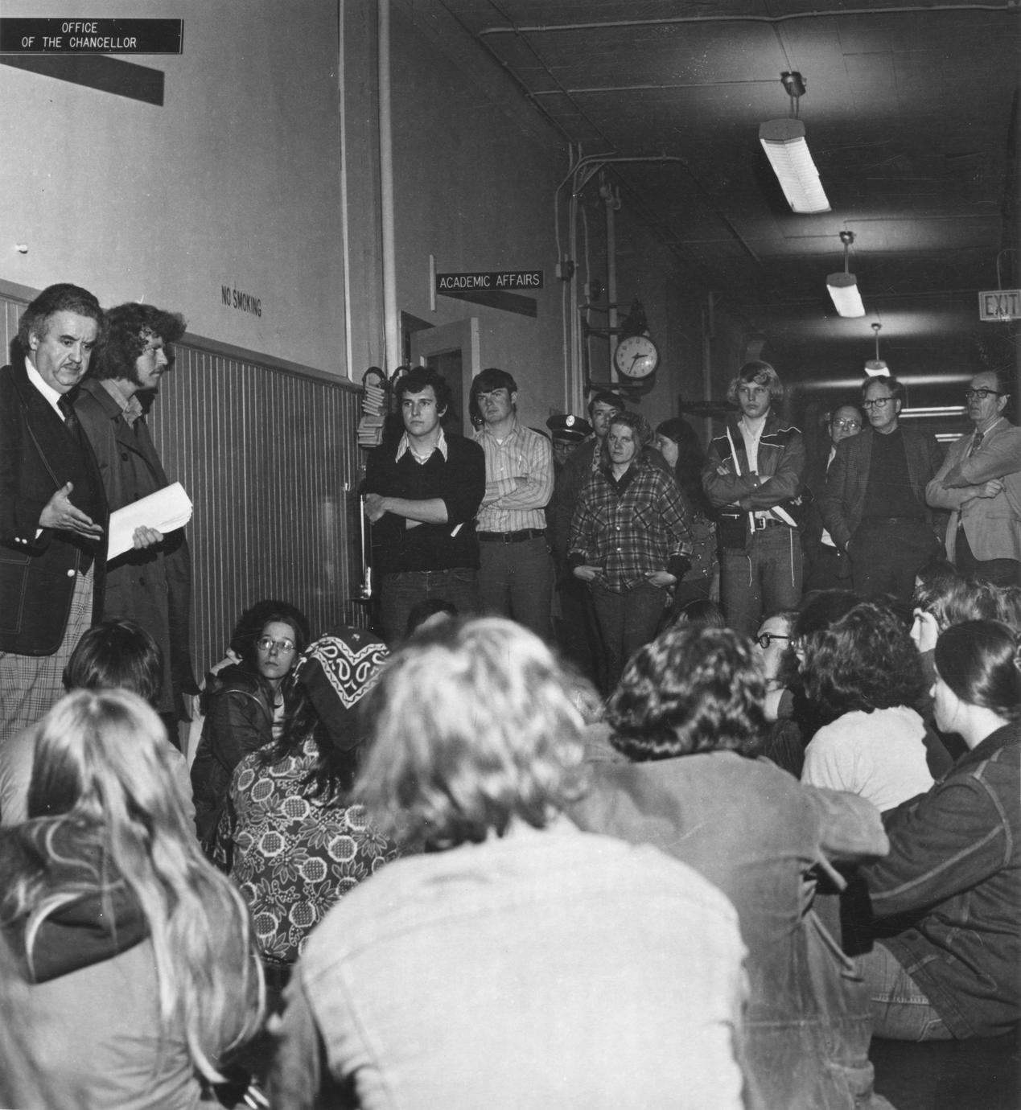
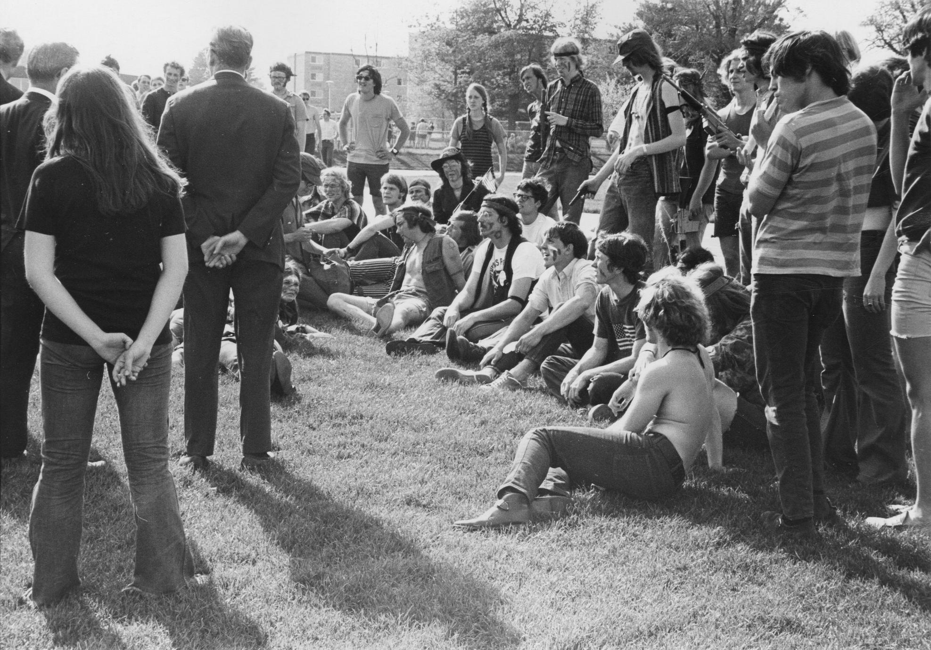
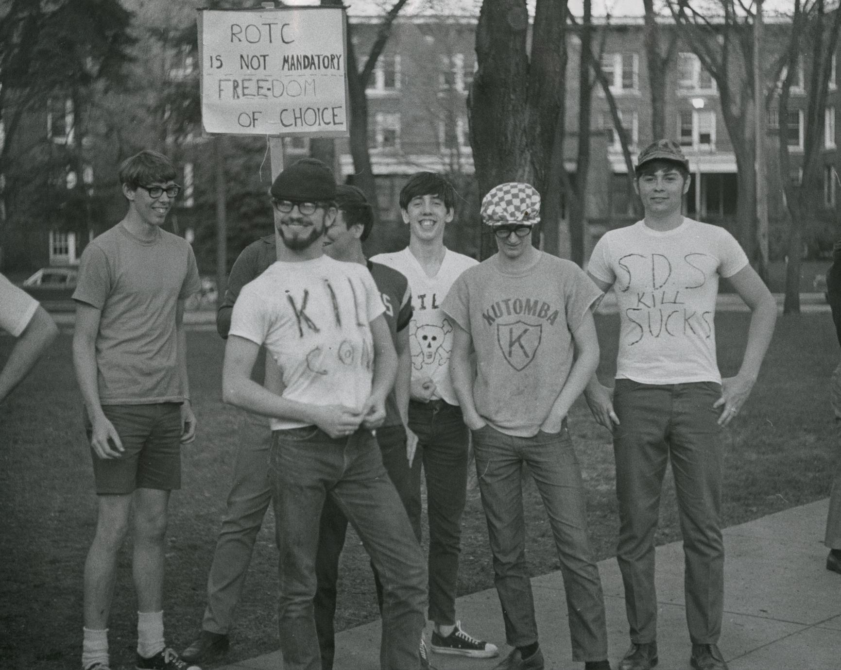
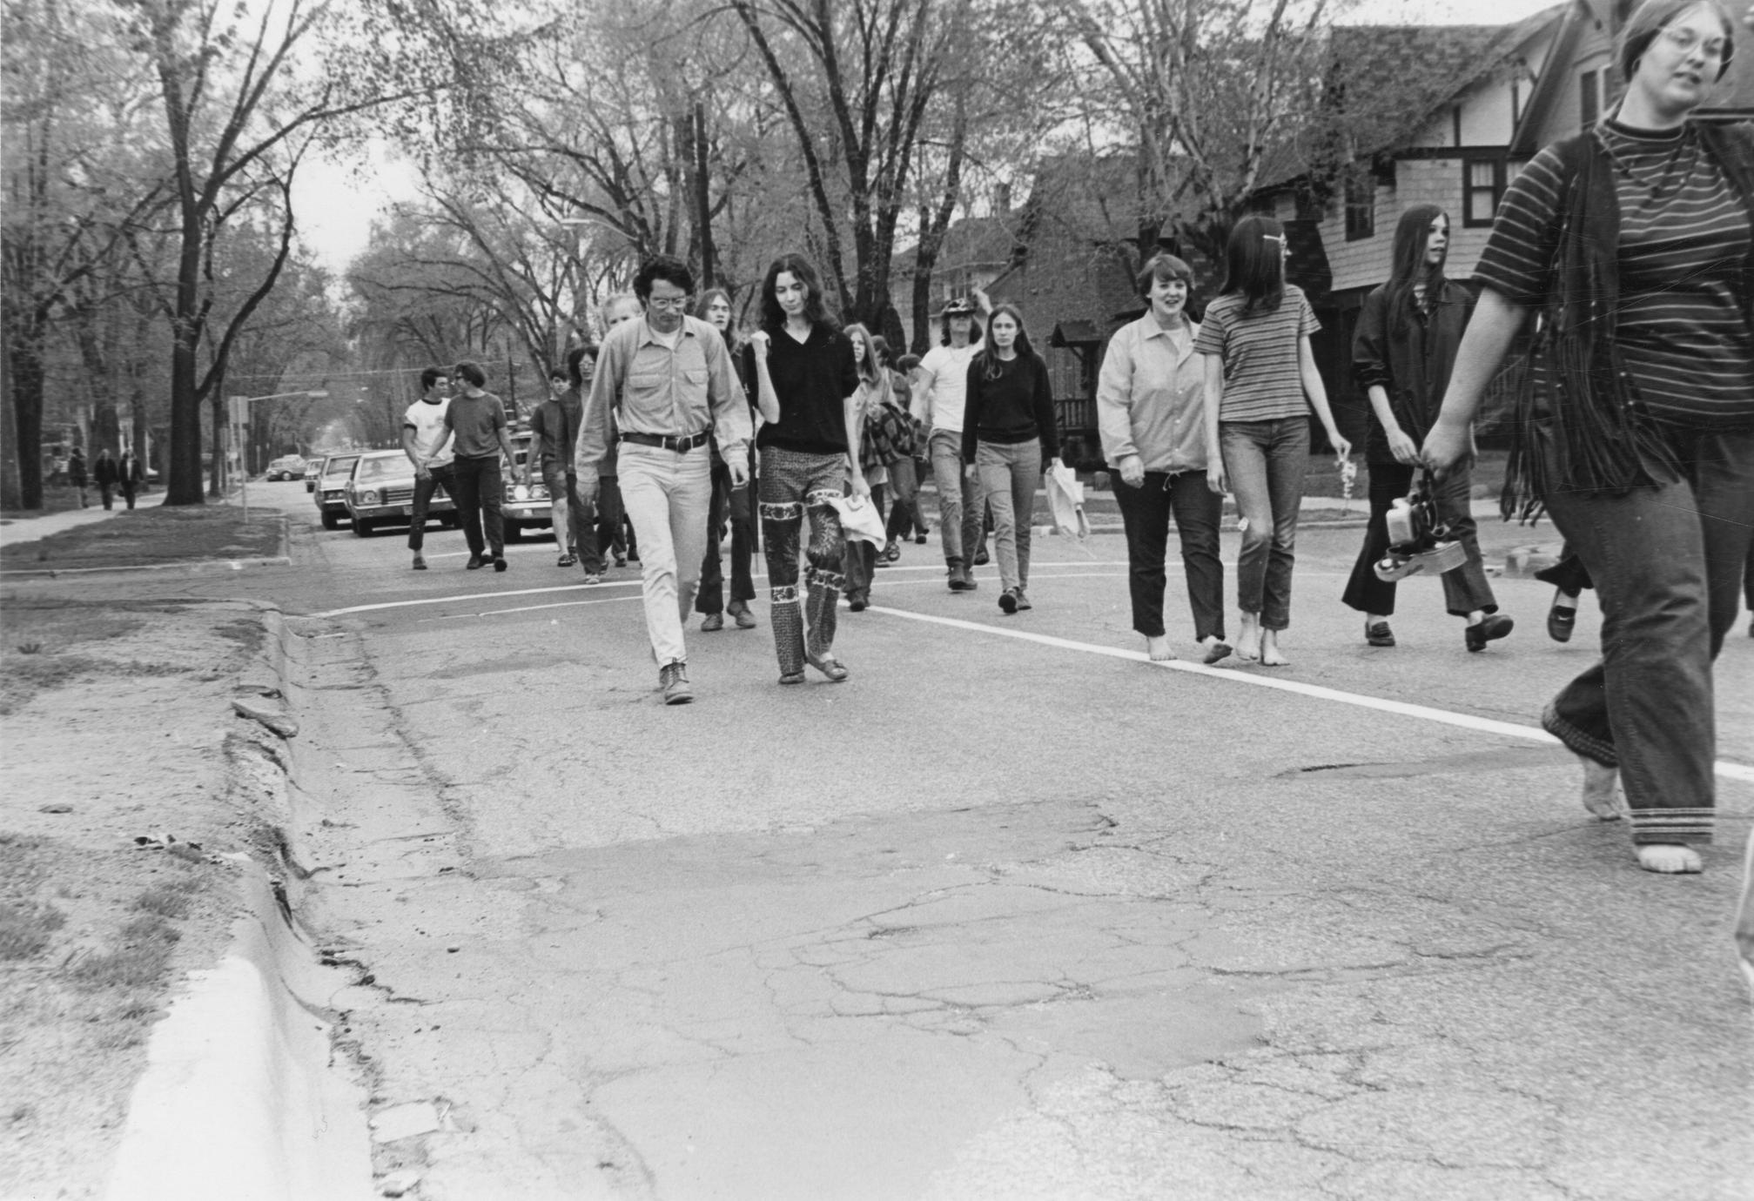
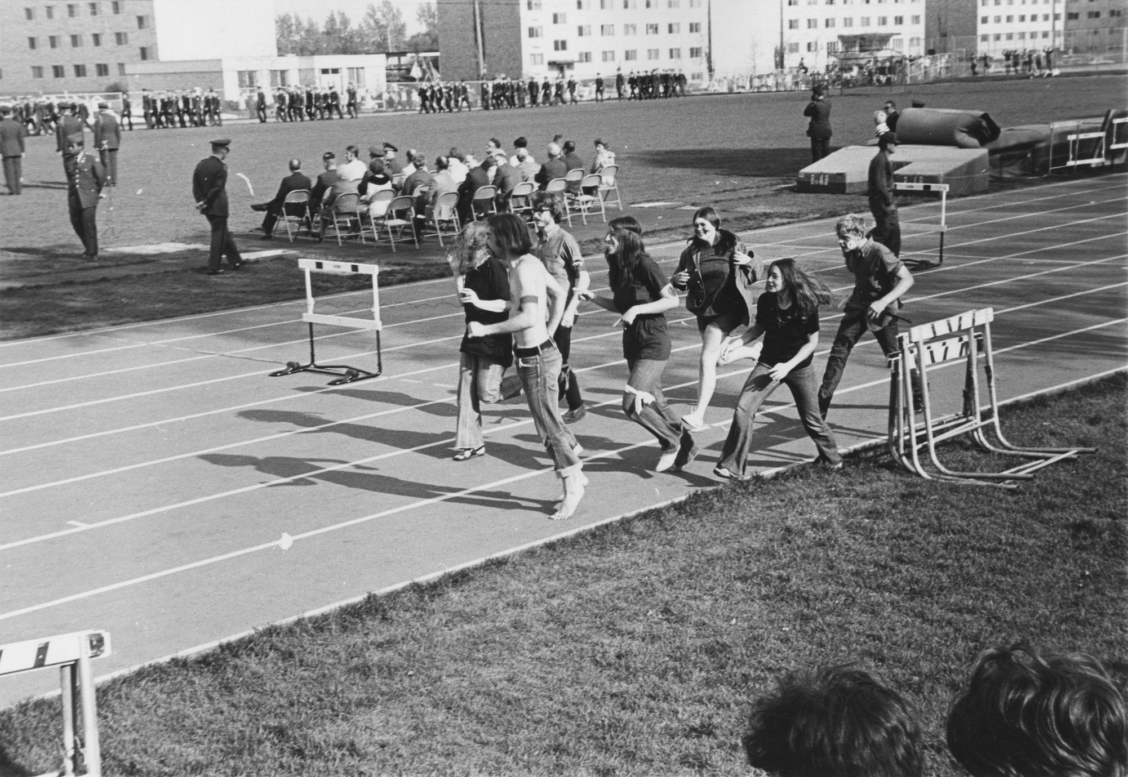
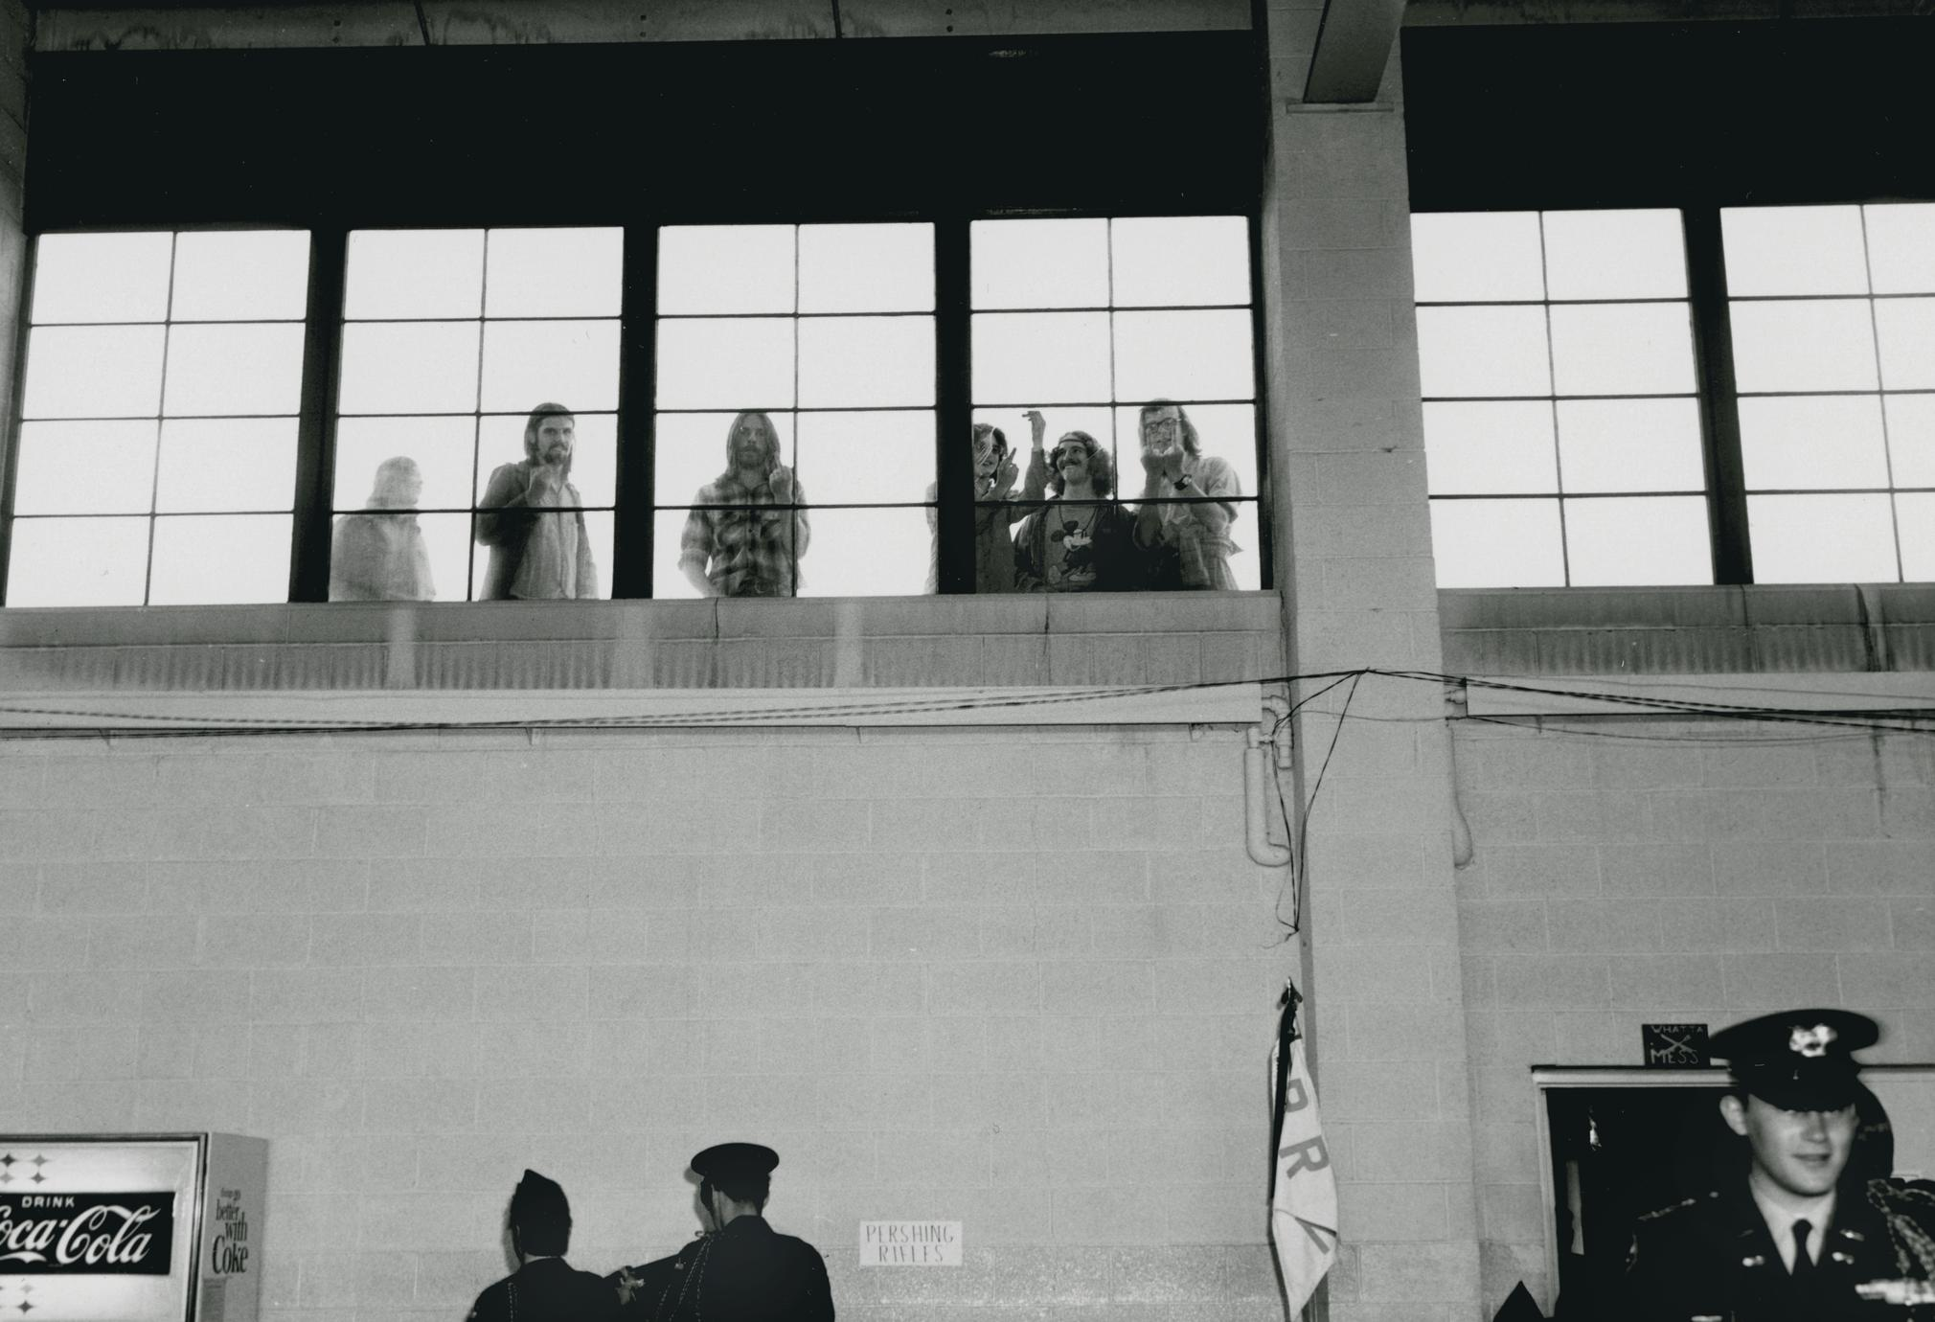
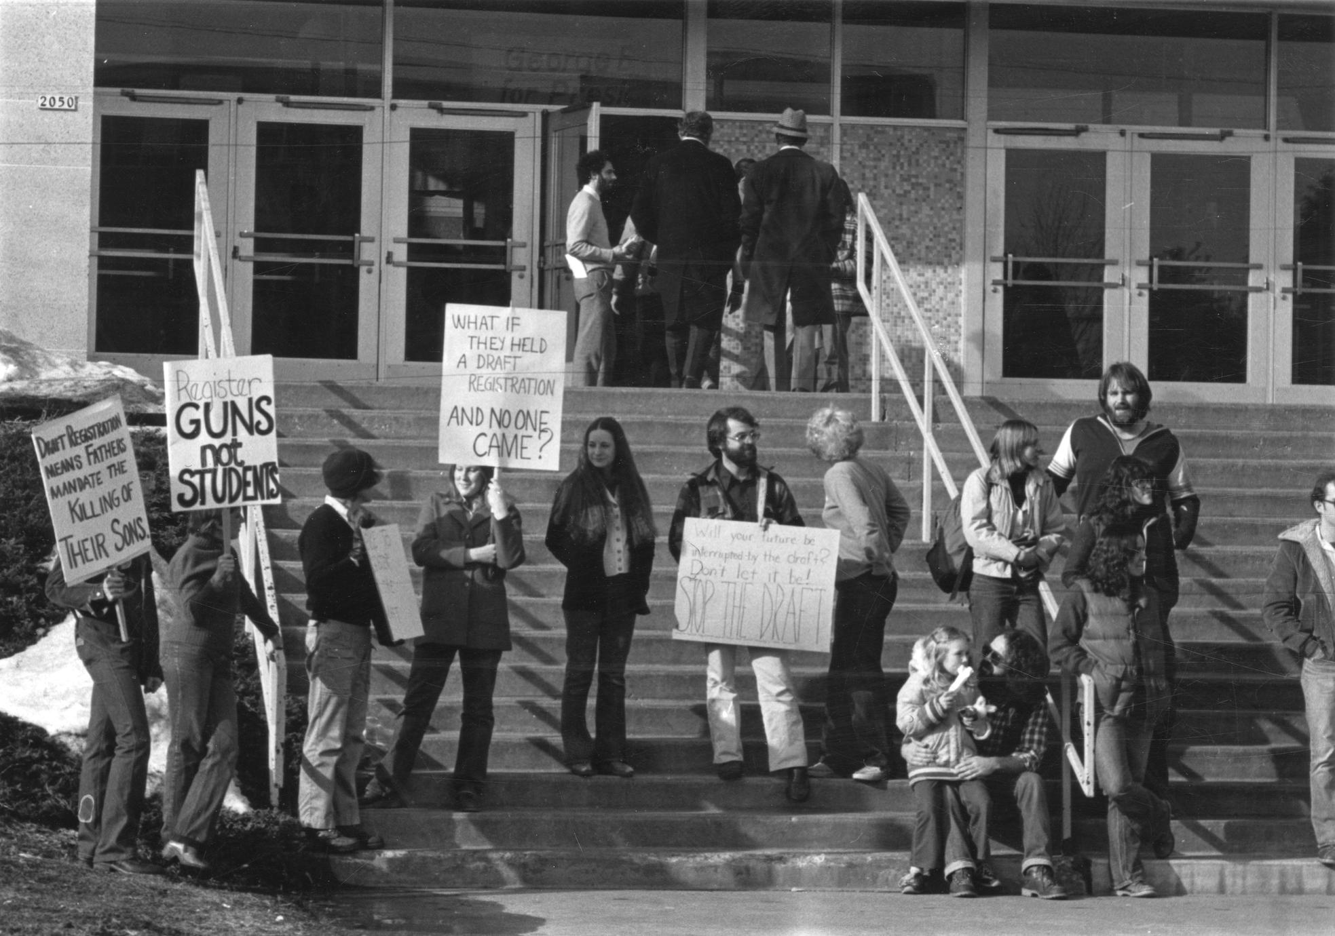
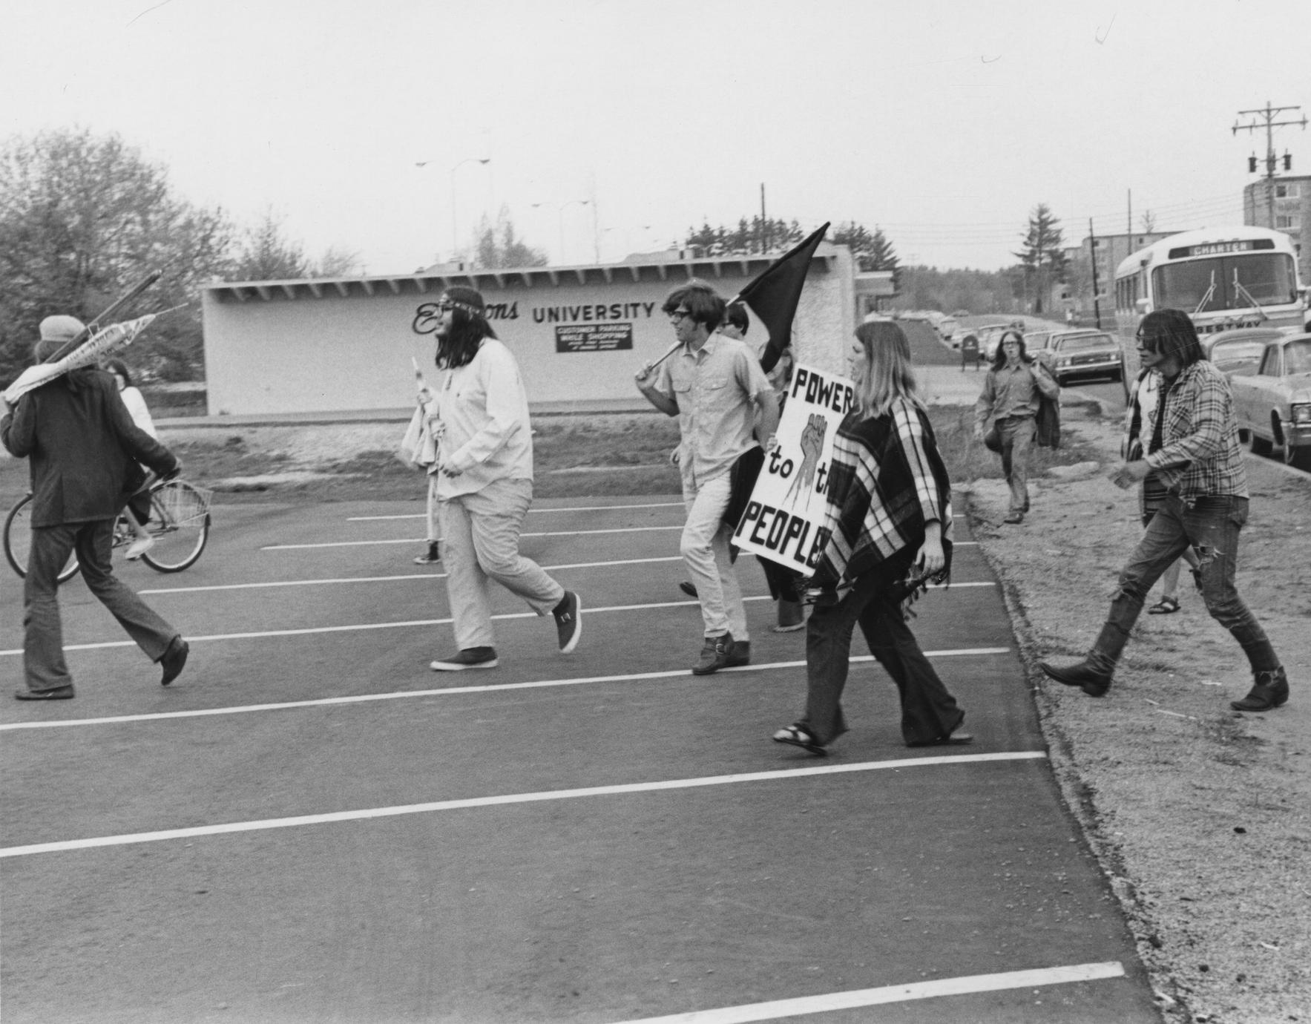
Notes:
WHat can photos twll us?

Slide 5
What can photos tell us about the past?
The people involved in events and protests: what types of people, ages, races, walks of life, etc.
What is happening in the past, gives us a glimpse into past events.
Shows us the where and whats of the events in the past.
Shows us visual trends over time.
Pictures can make past events feel more real and easier to conceptualize. They help us empathize and learn about the past in a unique ways.
(Image from cover slide)

Slide 6
Why were there Vietnam war protests at UWSP?

Slide 7
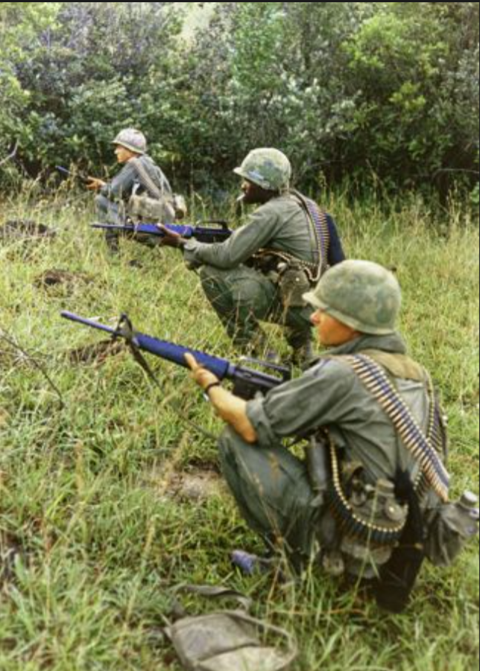
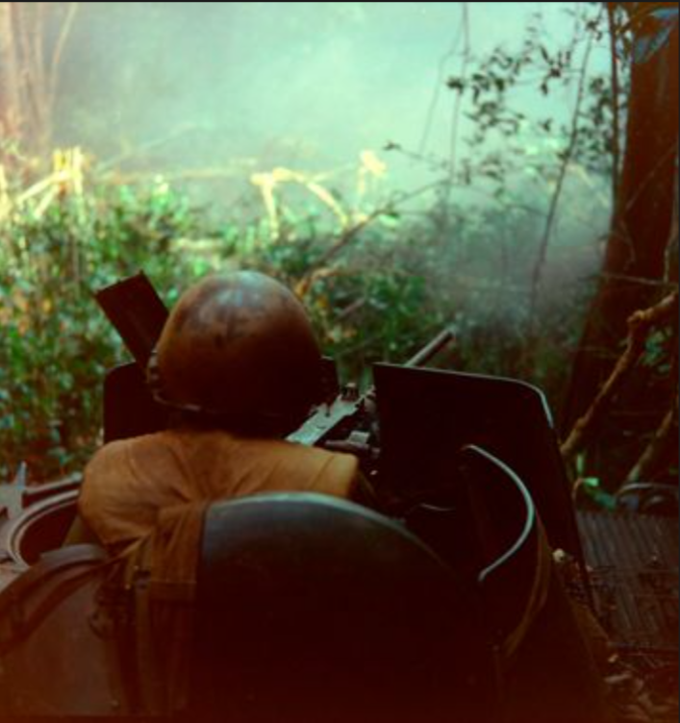
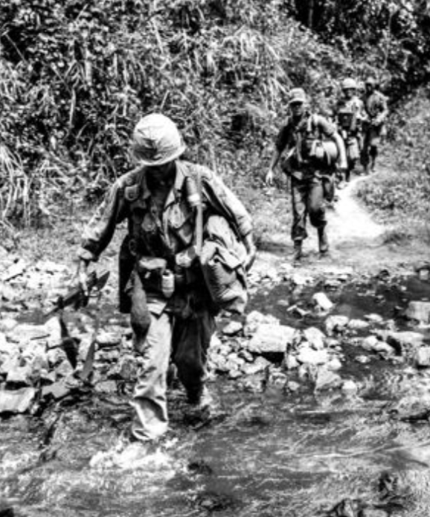
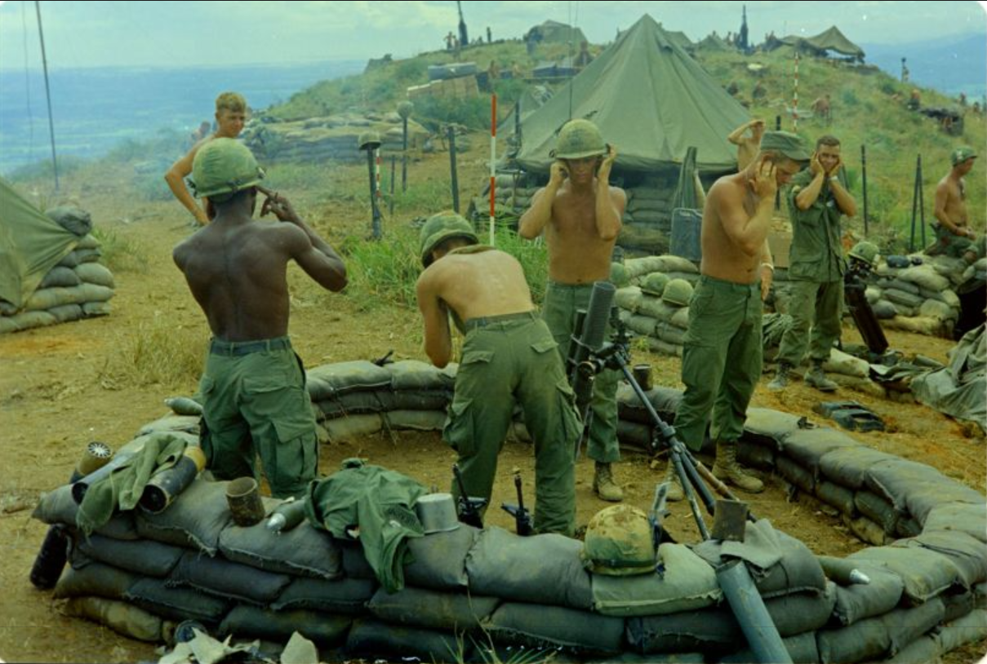
What is the Vietnam war?
This was a war in which the us was trying to stop the spread of communism in Vietnam. (very simplified summary of this war and it goals)
It lasted from 1945-1975 (30 years)
Also known as the war with no end for how long it lasted.
It as seen as one the most controversial wars in US history for the treatment of US soldiers, brutality and lives lost, reasons for joining the war to begin with, etc.
The controversies with this war don't end with war itself however but also with the mistreatment of veterans that were injured physically and or mentally by the war.

Slide 8
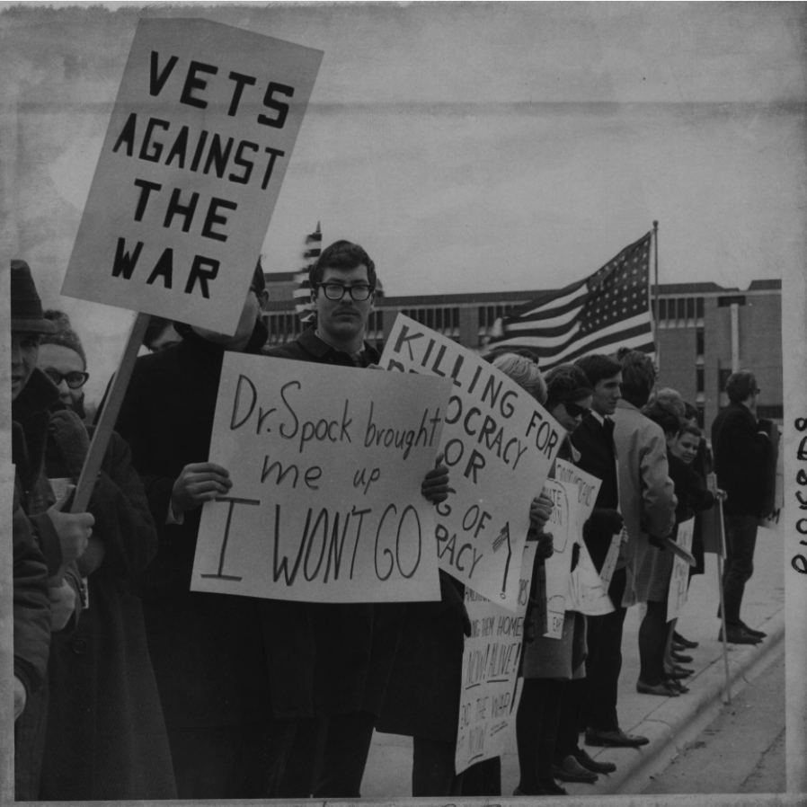
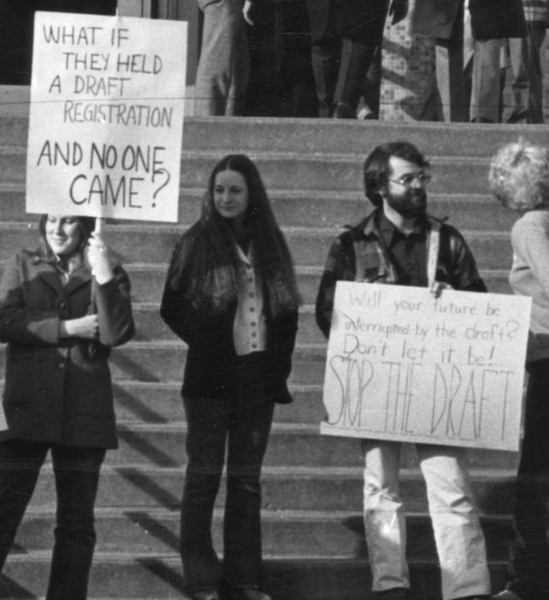
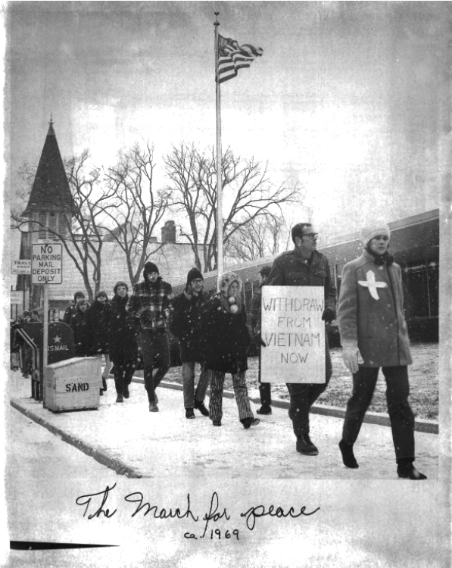
Why were people against it?
Why: The draft, Civil rights and peace movements, treatment of soldiers and civilians in vietnam(brutality of the war), reasons for fighting the war, treatment of veterans etc.
**The draft was one of the major reasons people protested this war.
-Those who didn't have to worry as much about losing their job where at an advantage protesting this war. Ex: Clergy(church staff), pacifists, activists, writers, college students
-Women were also except from the draft, so this offered them a unique opportunity but they could still be fired from their job for potesting.

Slide 9
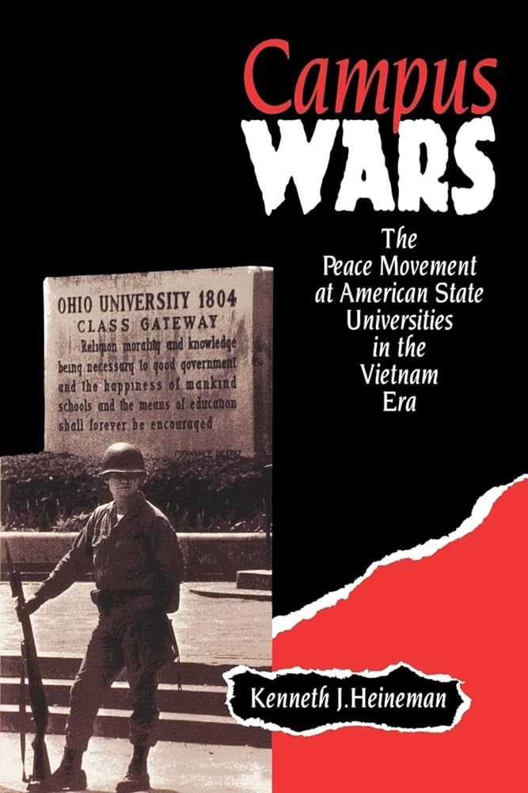
Why college students?
Exempt from the draft:
- College students where exempt from the draft so this offered them with a unique opportunity, and safety. Also they did not have to worry as much about job termination as they were students.
-Additionally professors often played an important role as leaders of demonstrations and movements on campuses. But they were not protected from the draft or termination.
The book Campus Wars details a lot of this protesting history during the vietnam war era on college campuses.

Slide 10
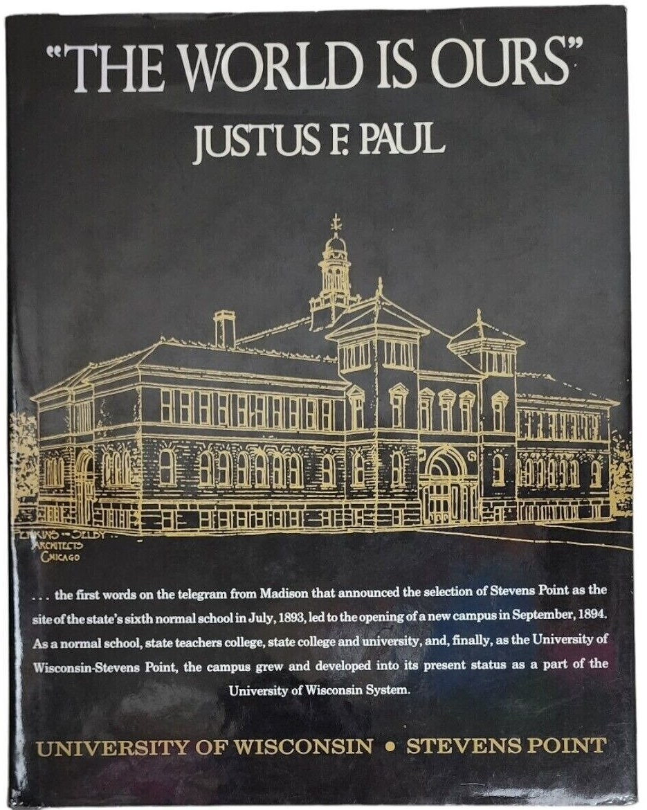
Things going on at uwsp during the war.
3 presidents of the collage:
William C. Hansen, 1940-1962
Presidency affected by WWI mostly.
Collage had a military training department.
James H. Alberson, 1962-1967
Young, ambitious and policy active with vietnam politically, died in 1967.
Lee Sherman Dreyfus, 1967-1977
Much of the protest and sit ins over the war in Vietnam occurred during this time.
Many pictures of protests that have been documented but there could have been even more that were not photographed.
UWSP has a rich history of counter culture and protests that even in some ways still occurs today just not in the same ways as during this era.
“The World is Ours” goes through a very detailed history of uwsp from 1890s- 1990s.

Slide 11
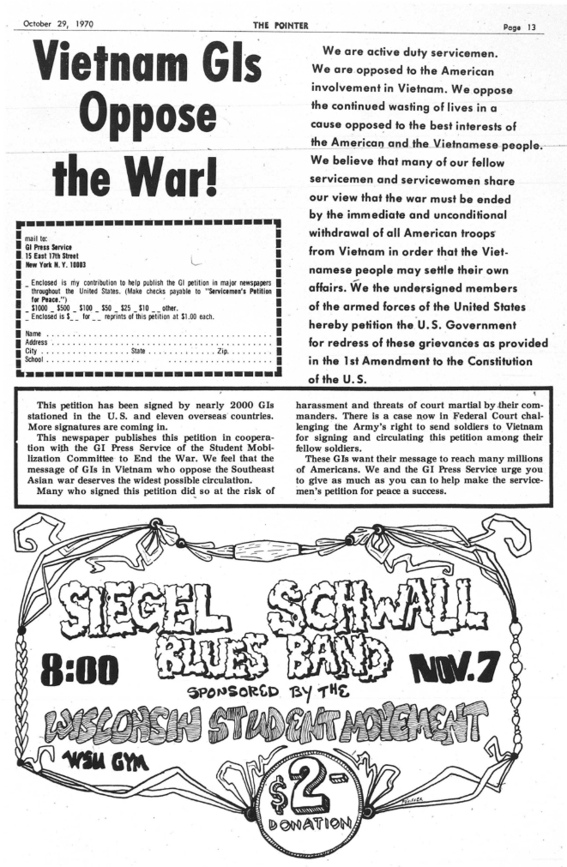
The pointer:
One page of the October 29 1970 issue of the mainstream collage newspaper that mentions the vietnam war.
The pointer is a collage newspaper here at uwsp that still runs today.
It covers many topics but mostly ones of things going on on campus etc.
This is notable because this is not a political newspaper so it really shows that this was an important topic to either the creators of this newspaper or to college students in general.

Slide 12
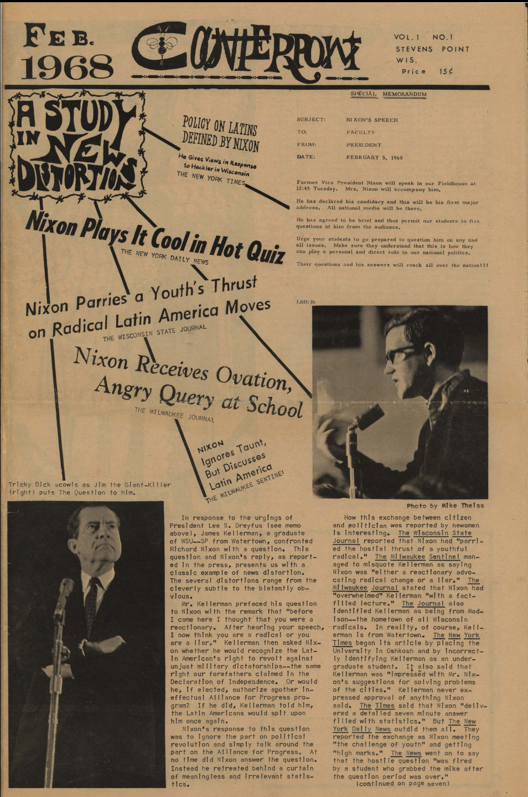
The Counterpoint newspaper
The Counterpoint is a counterculture political newspaper that started during the vietnam war era and acts as a history of protests and counter culture at uwsp in a way.
Ran from 1968-1970
19 documented issues in the archives
Each issue talks about something counter culture related, but it features some local politIcs as well.
The very first issue has mentions of the vietnam war.
It answers the question of why at UWSP. There was a existing counter culture here evident though the pictures of protests and this newspaper.
These newspapers cover everything and anything counterculture and non-mainstream related. So an easier way to examine how these topics of focus changed over time is by looking at the covers.
Some of the covers feature art, things related to politics, or even pictures of people.

Slide 13
How the covers changed over time:

Slide 14
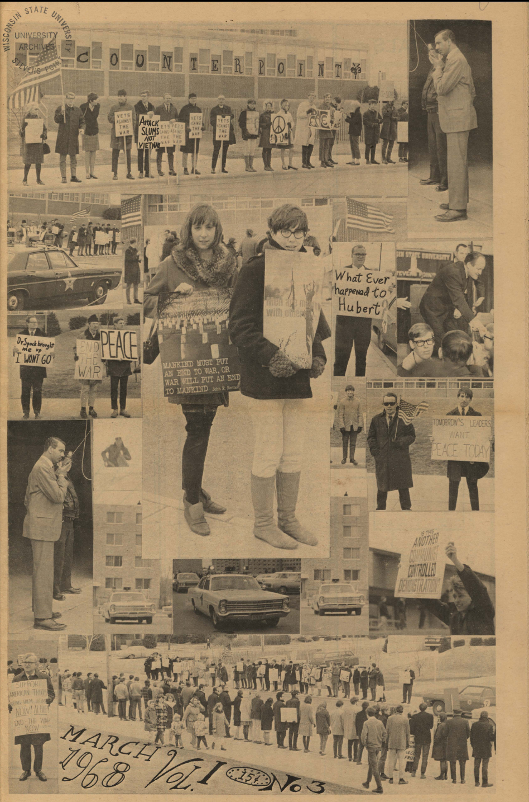
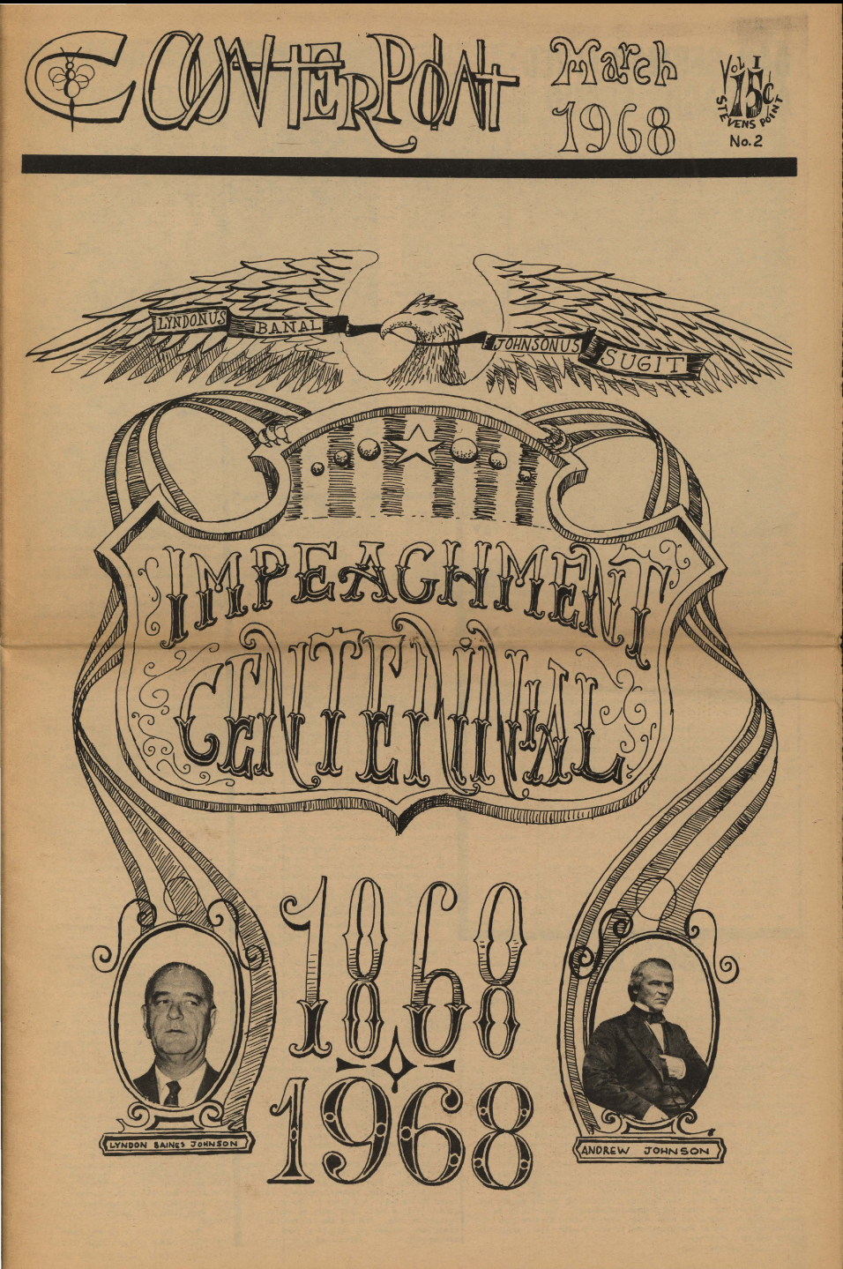
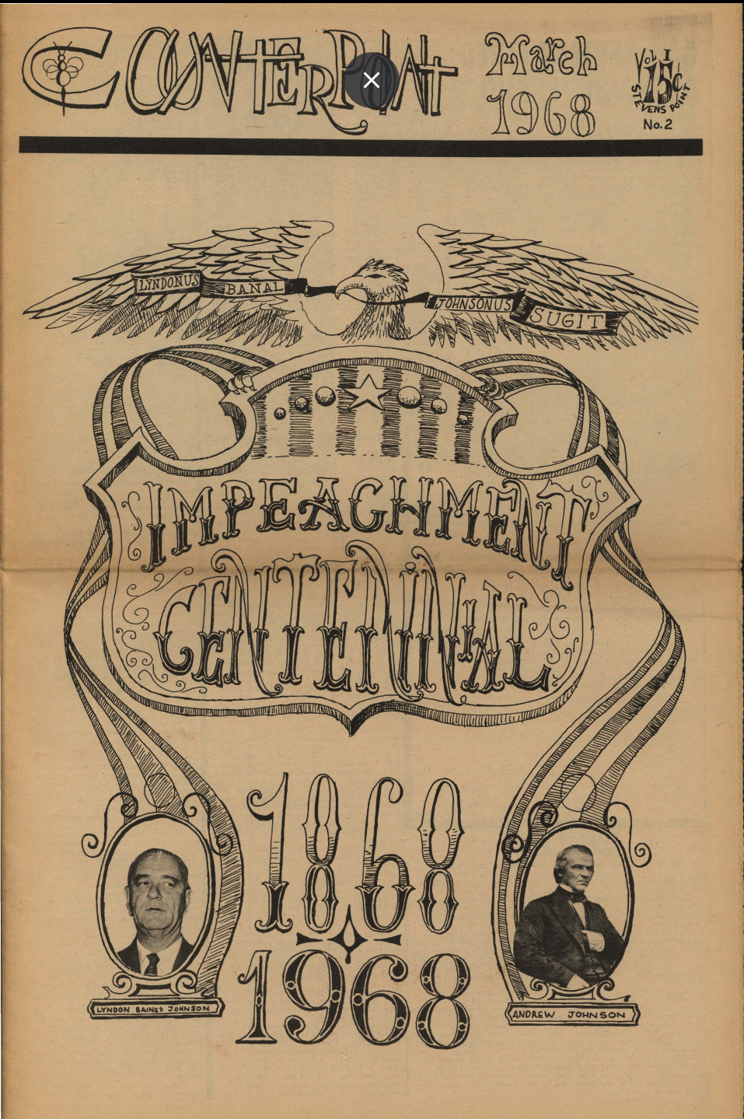

Slide 15
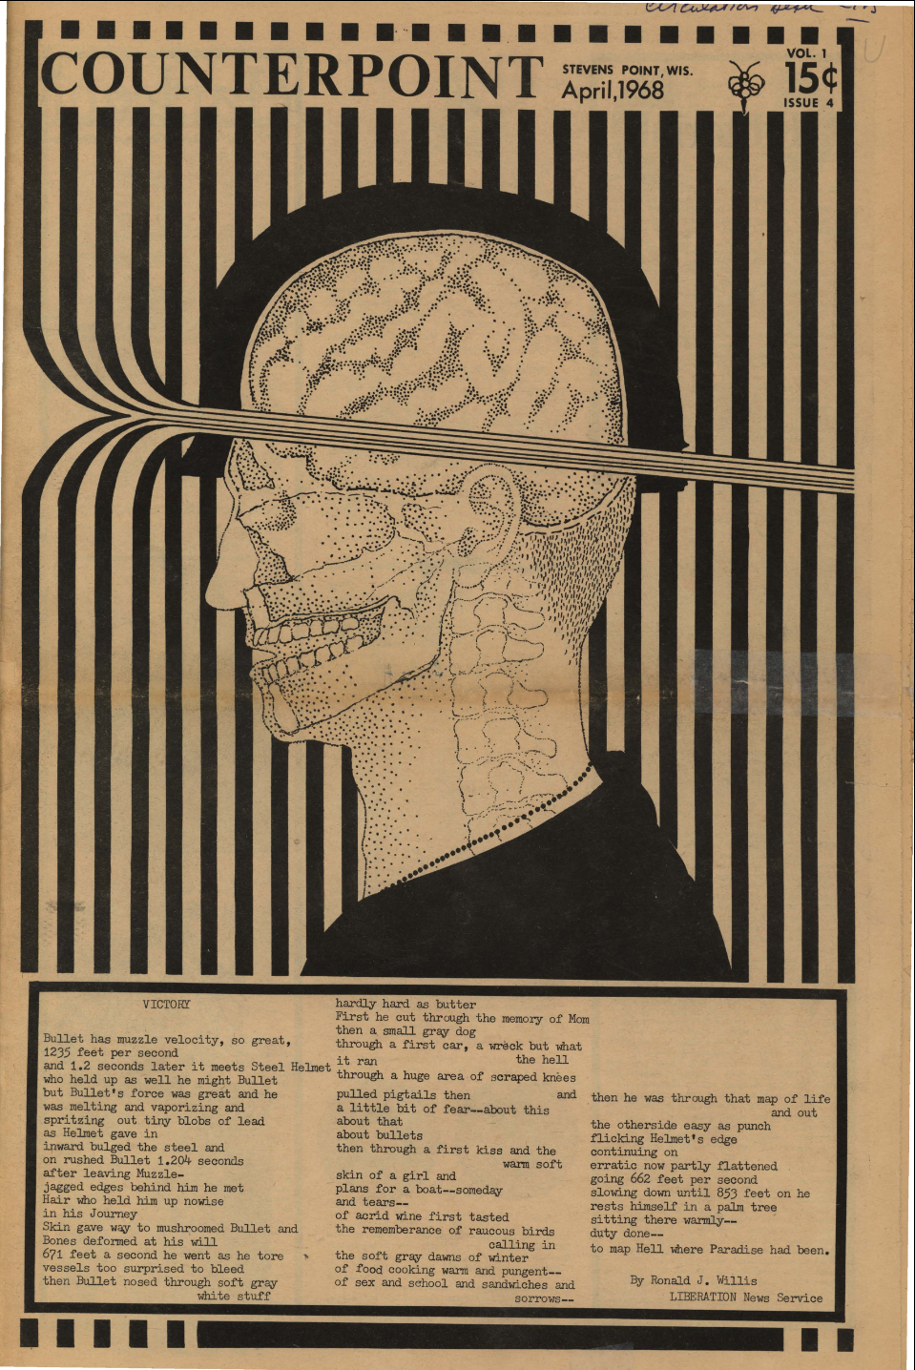
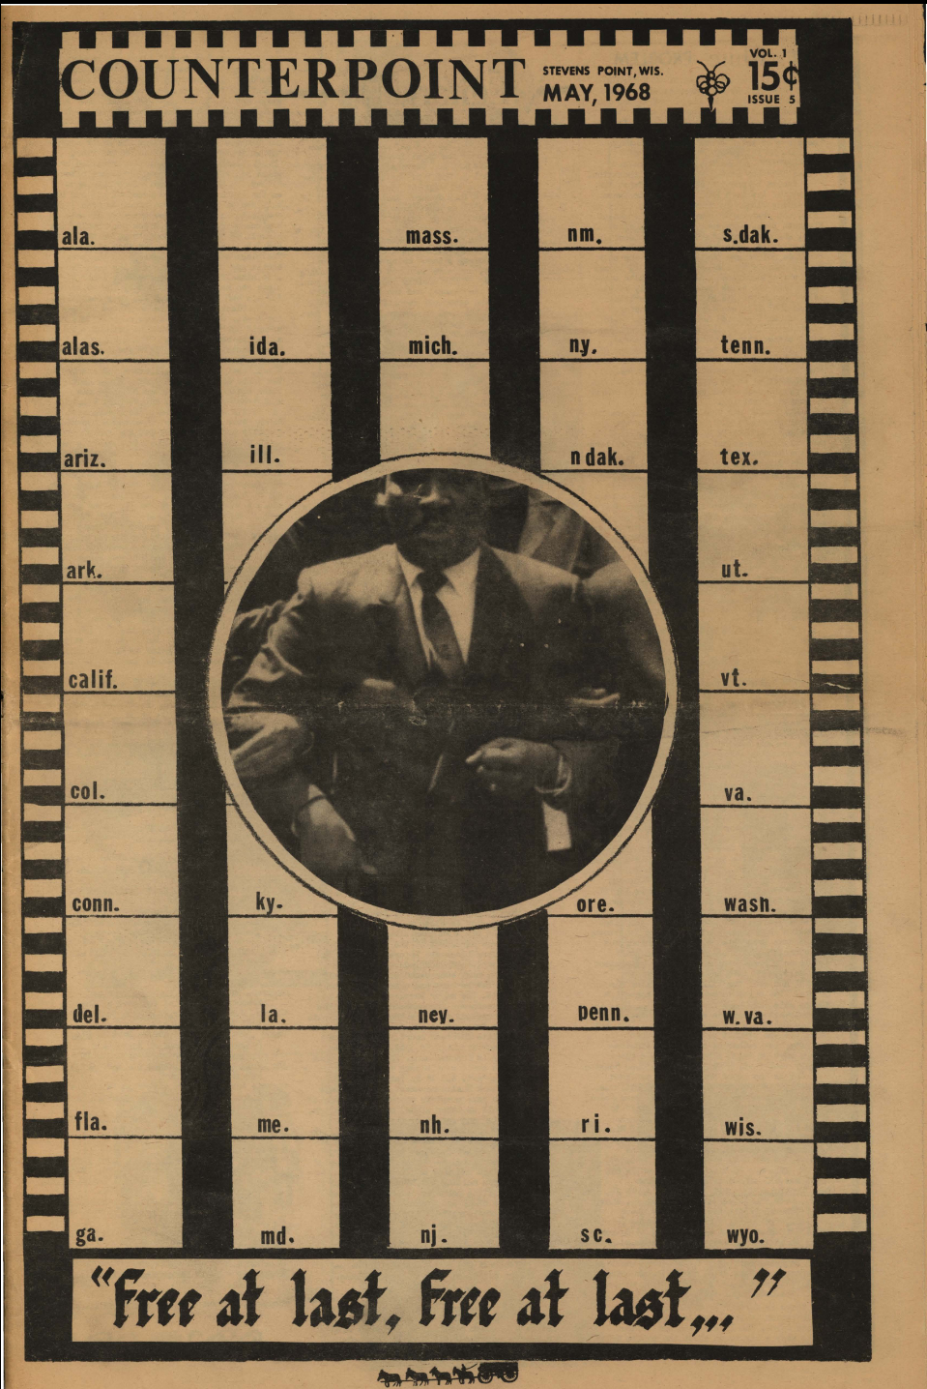
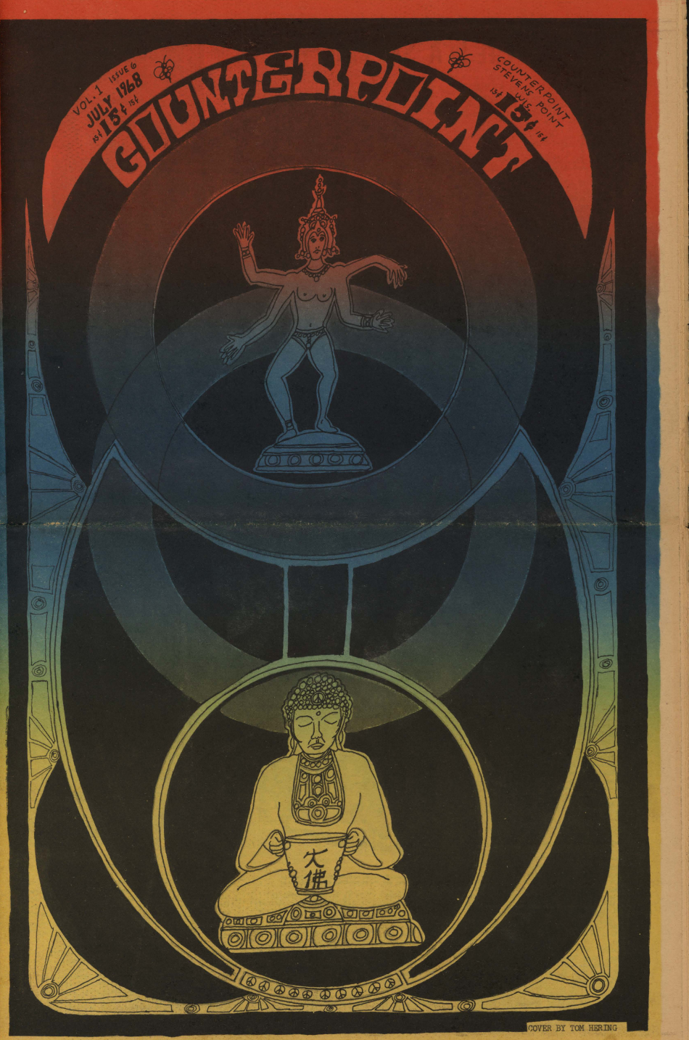

Slide 16
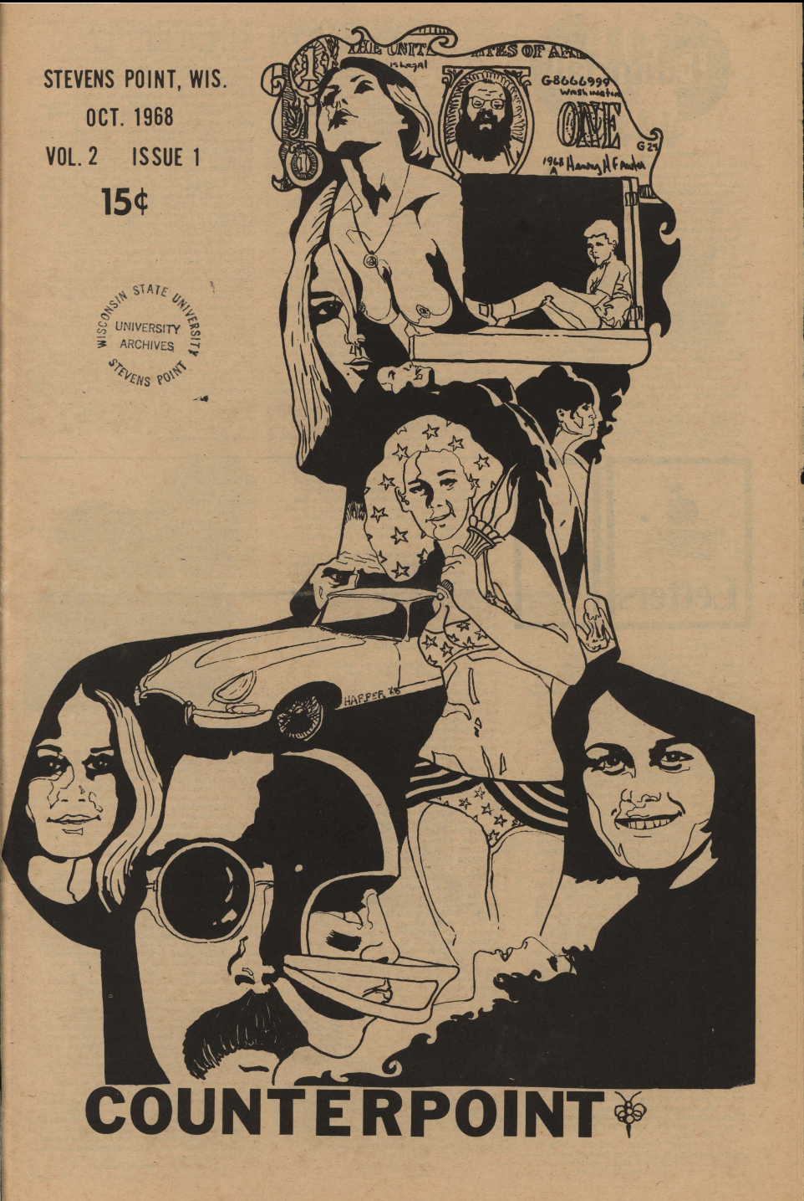
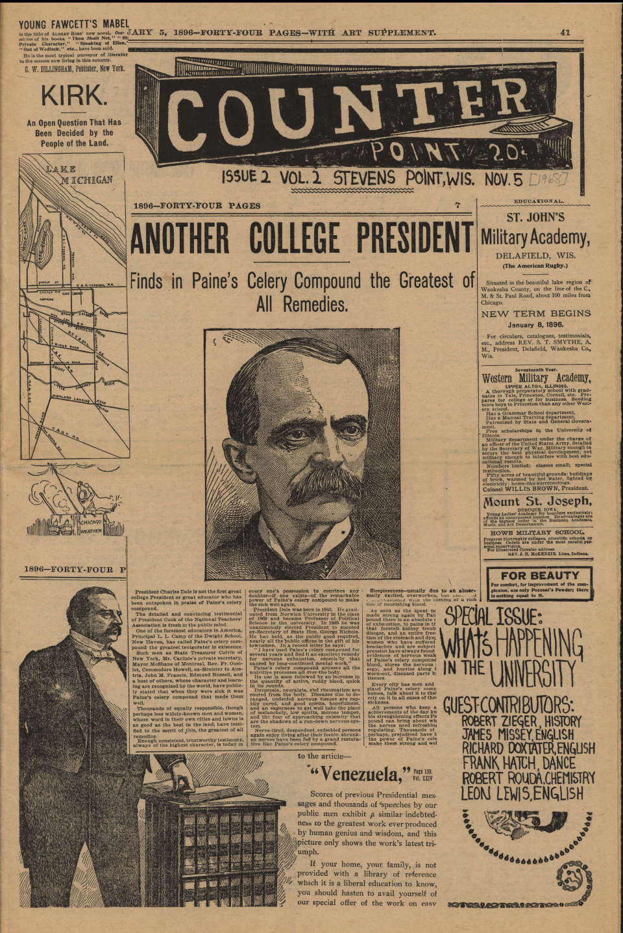
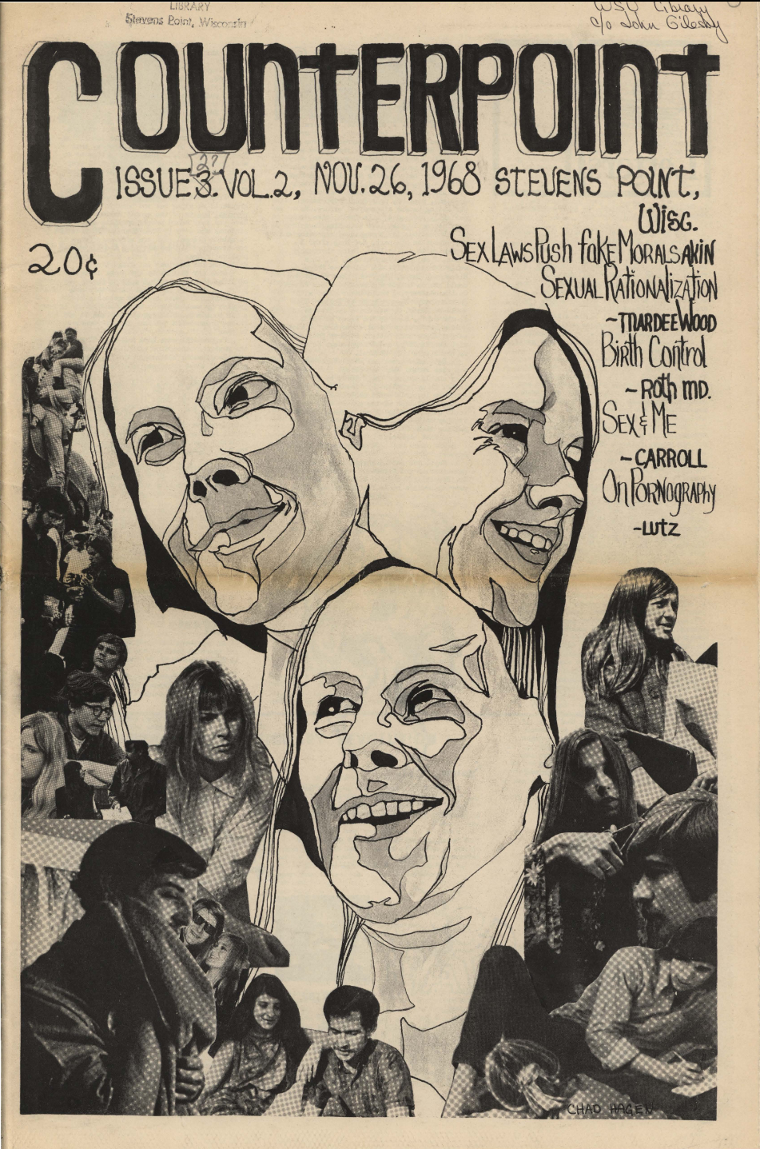

Slide 17
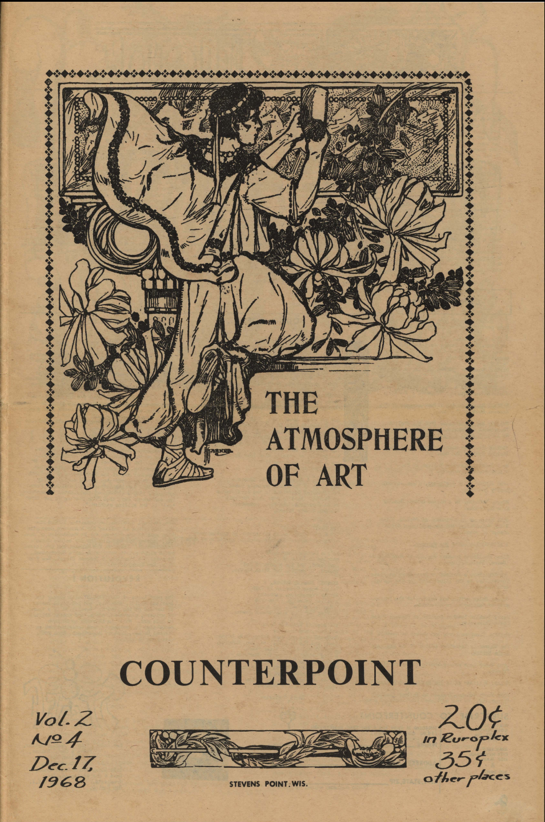
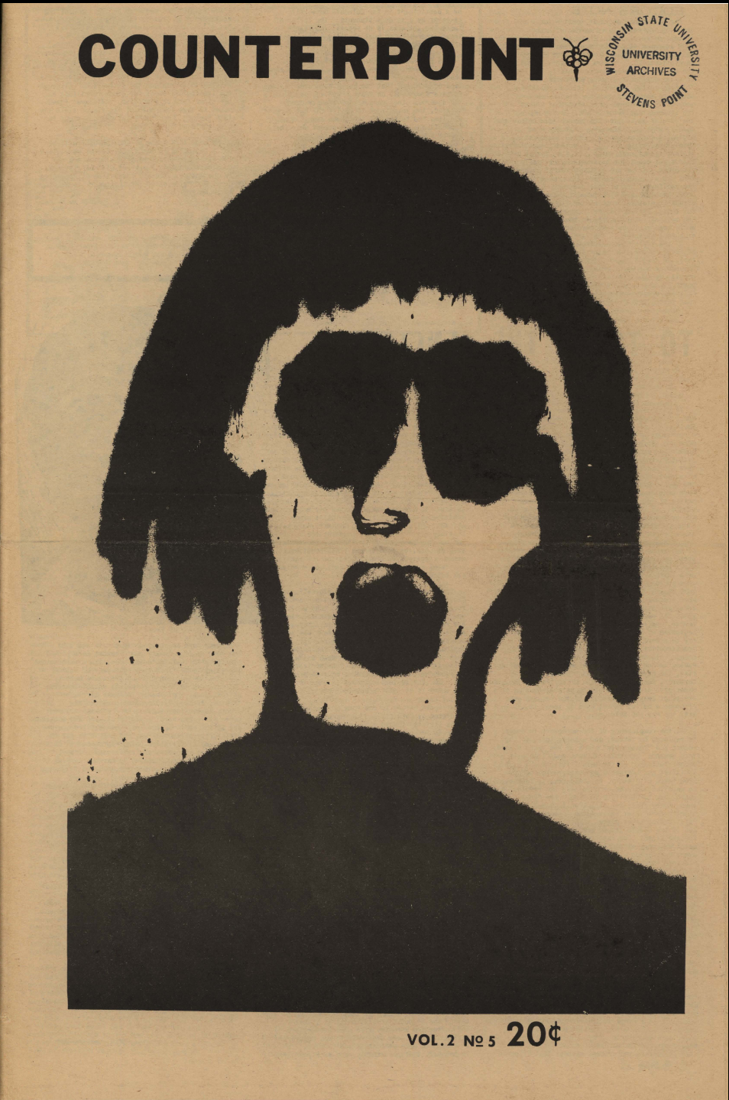
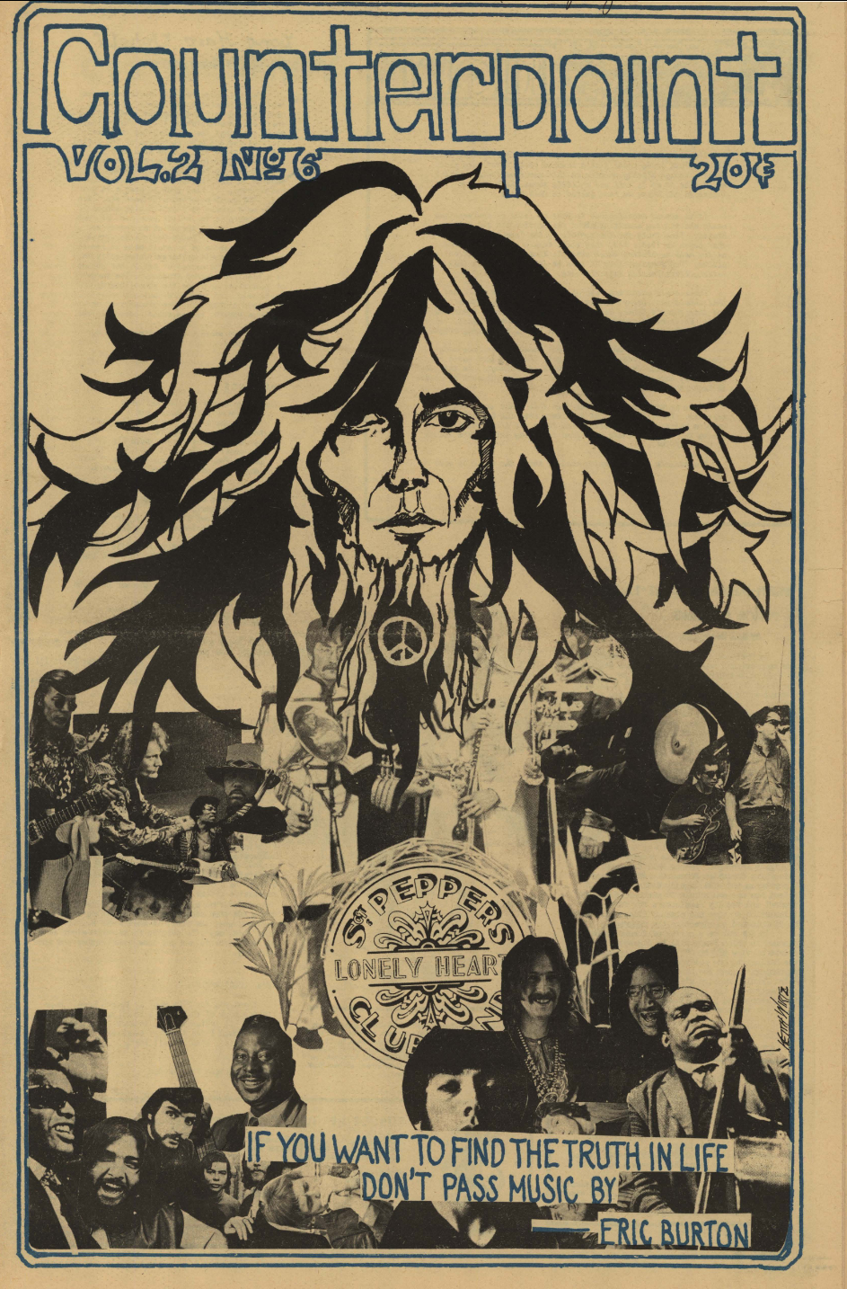

Slide 18
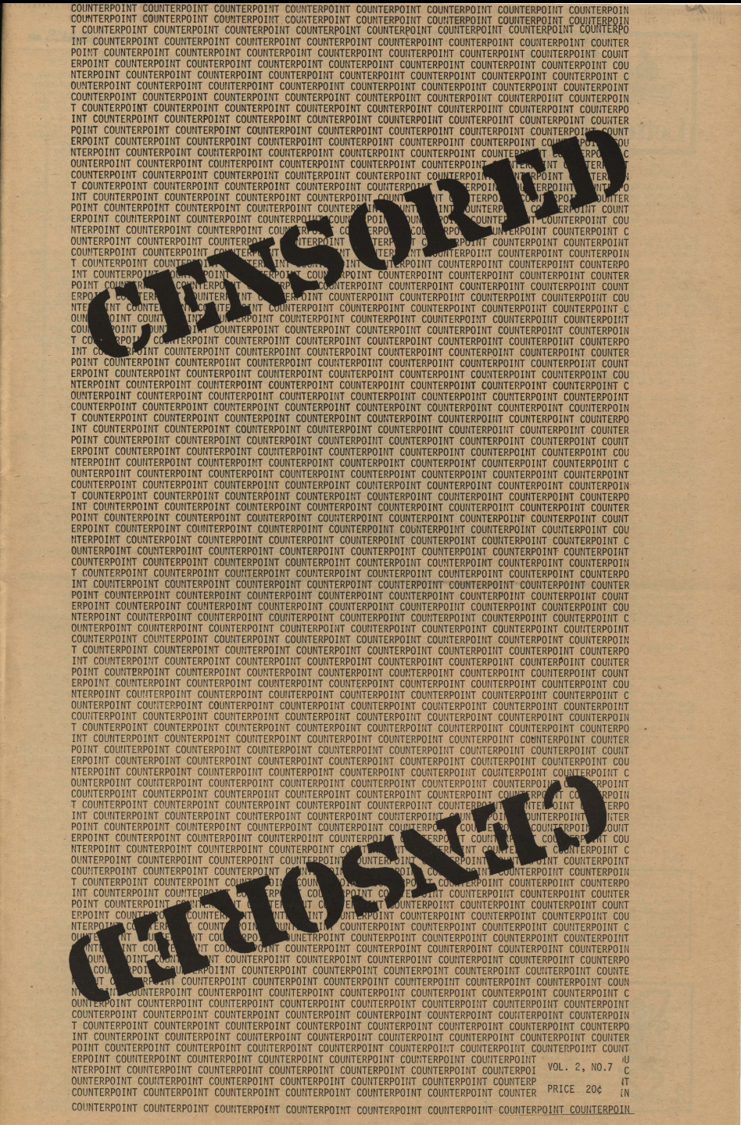
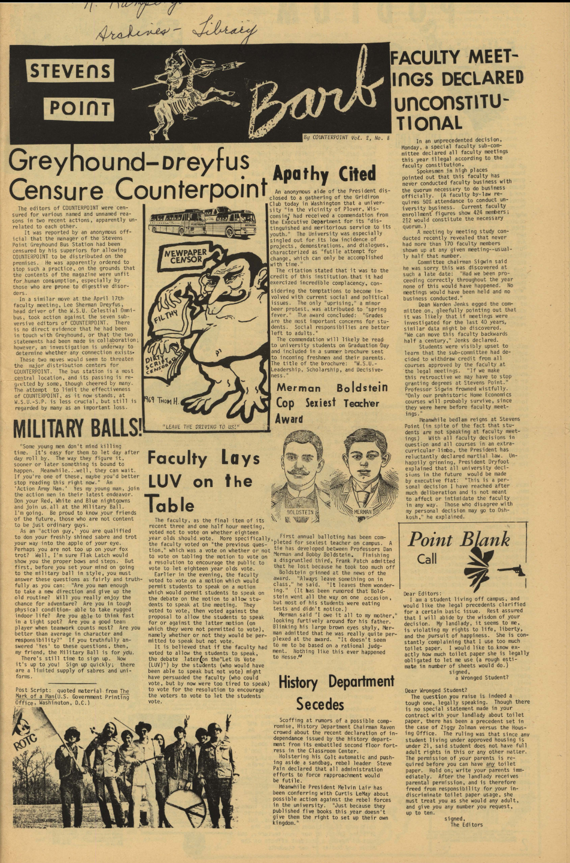
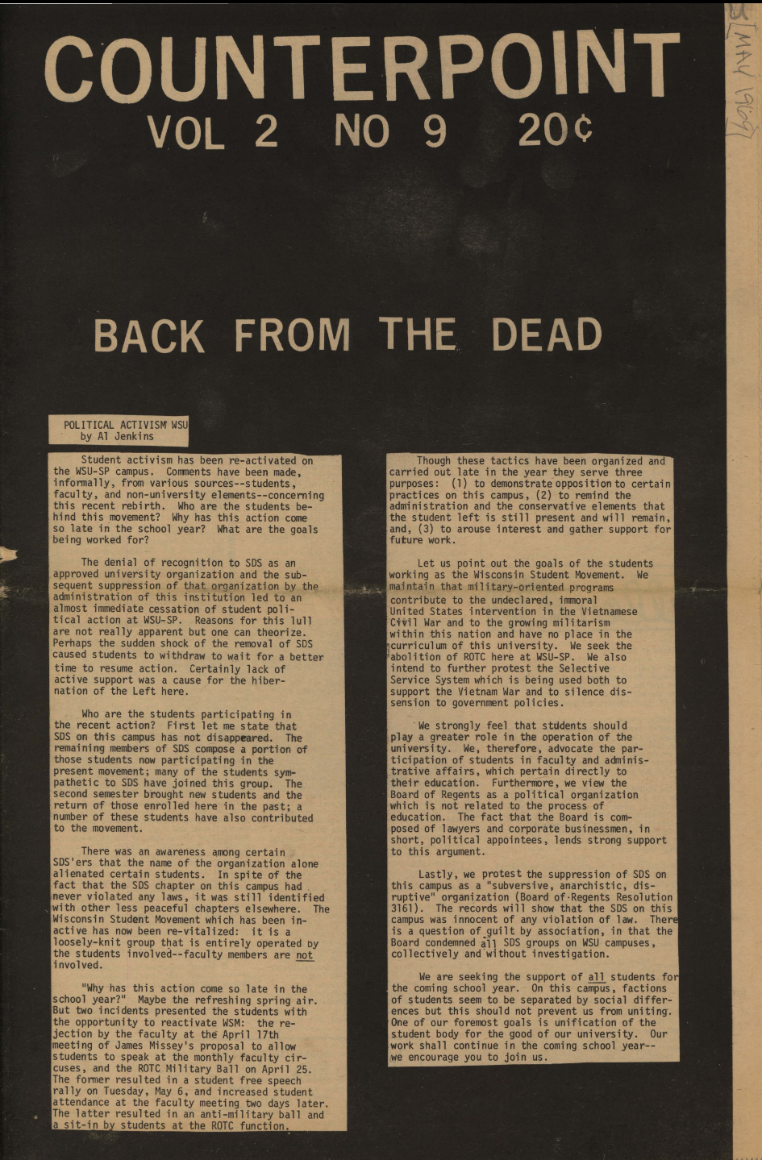
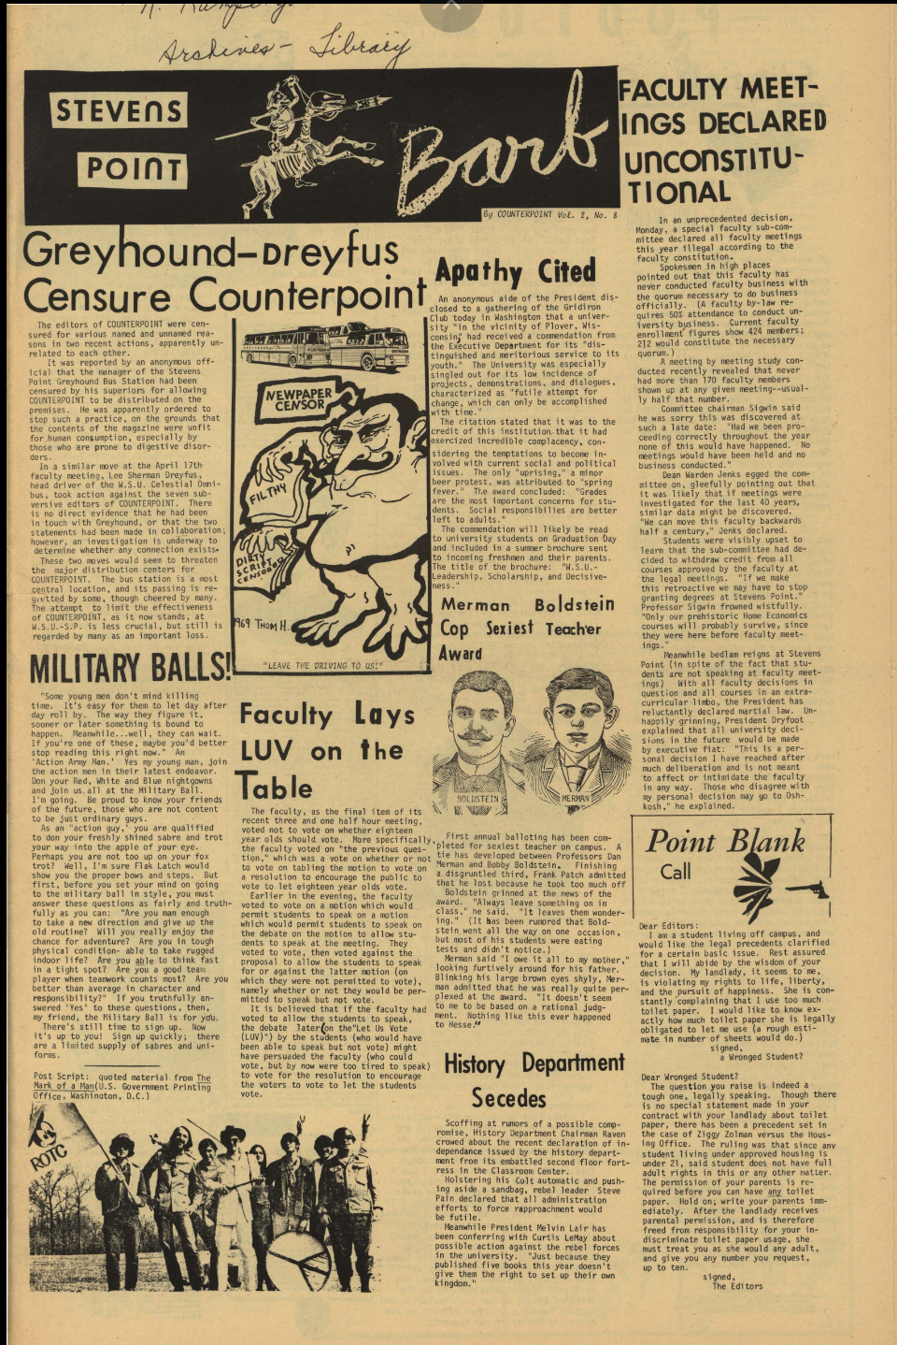

Slide 19
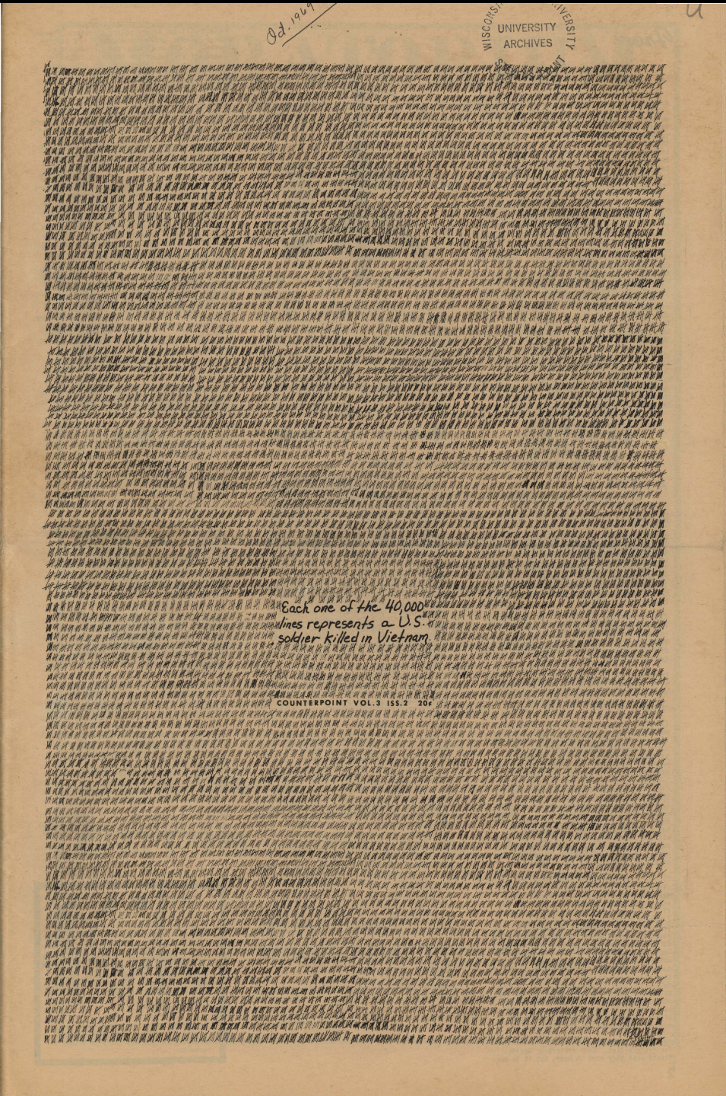
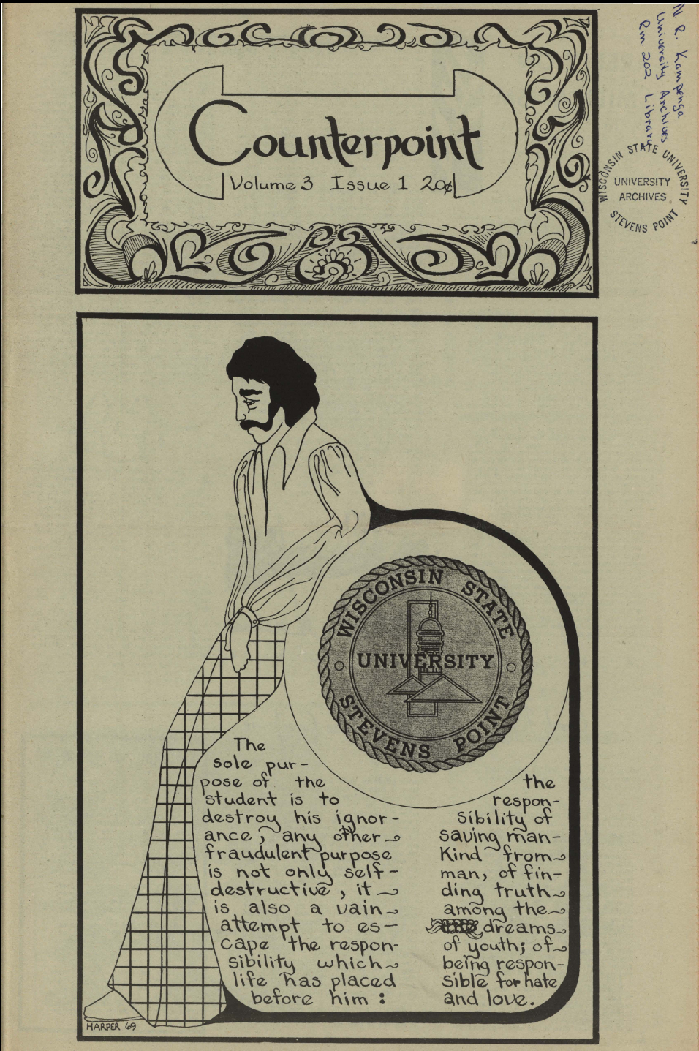

Slide 20
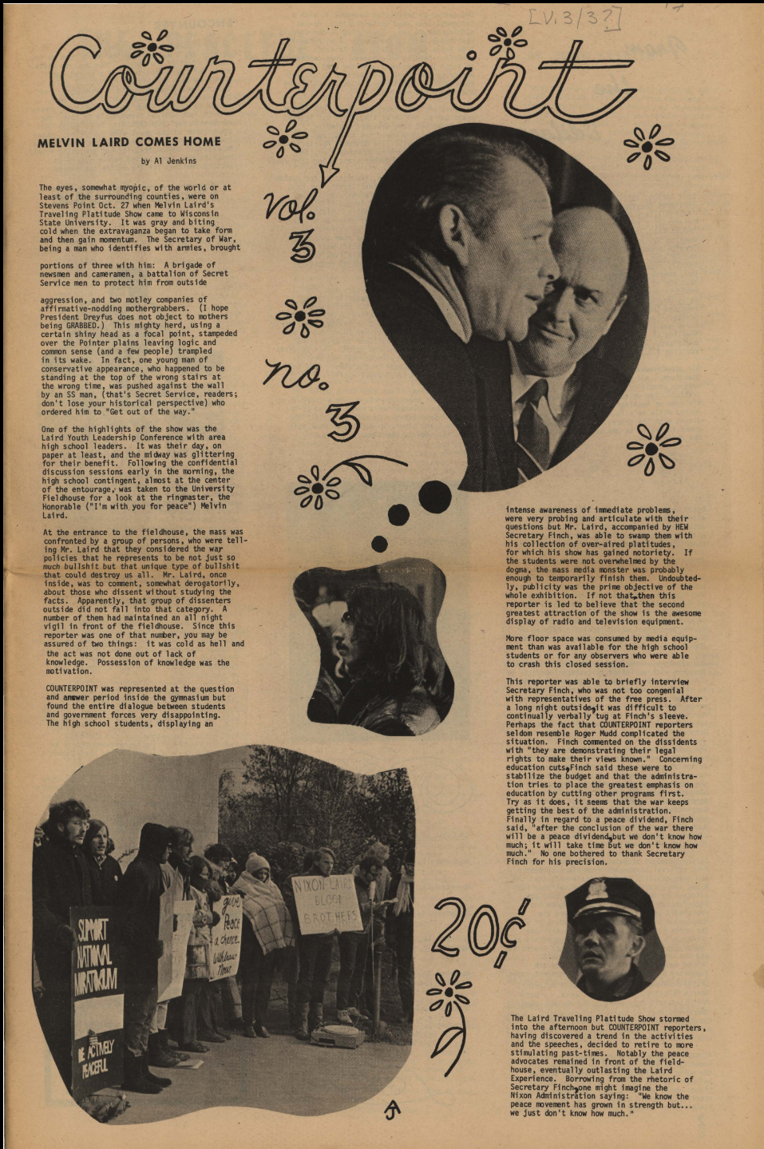
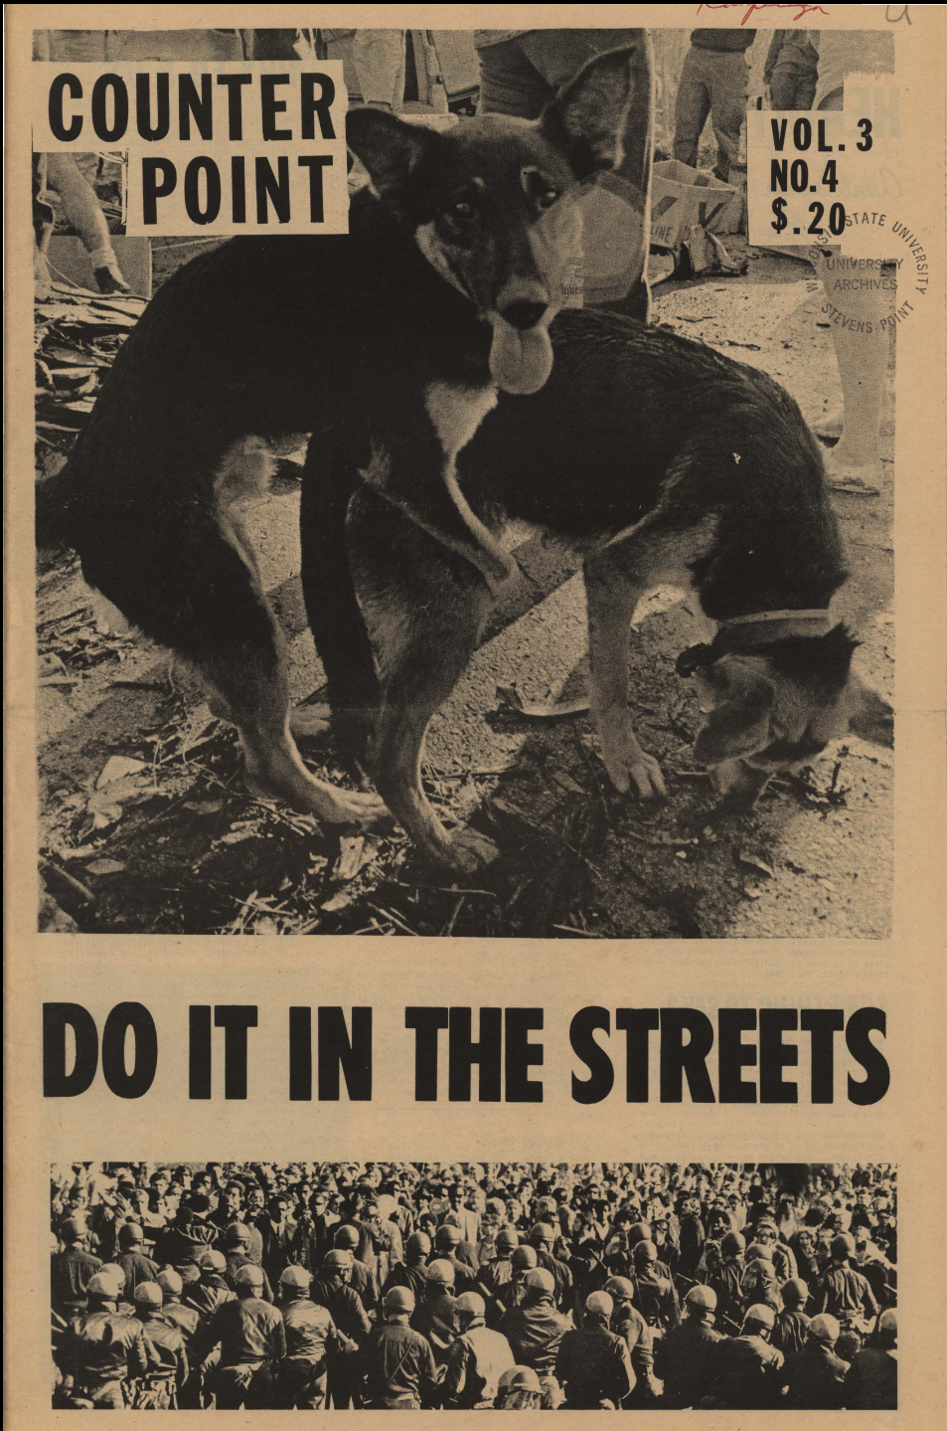
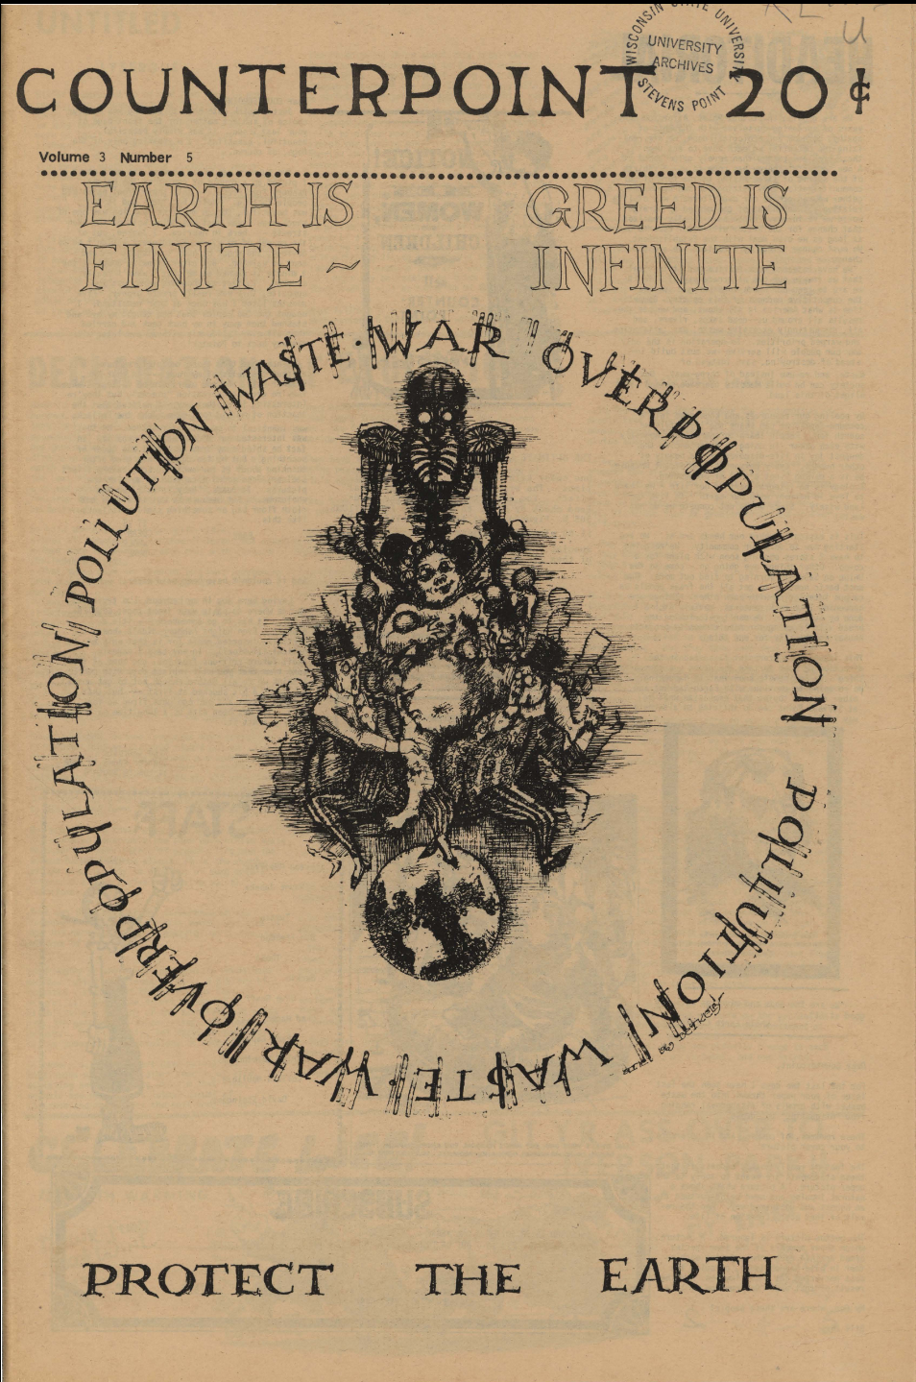
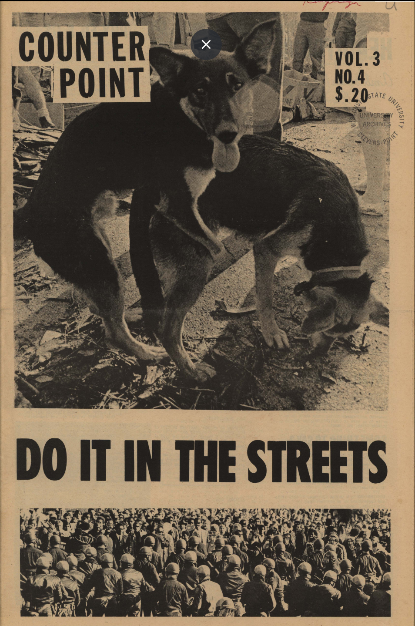

Slide 21
What do the covers tell us?
-Active political scene on campus
-Political statements, what they were trying to say
-Insight to the counterculture here (real images of people)
-Importance of art in movements, eye catching and bold
-Humor used
-Creative individuals and how they aided the movement
-Insight into the contents and topics covered

Slide 22
My sources- Photo Databases and Newspapers
Photo Databases:
National Archives. The U.S. National Archives and Records Administration,
https://www.archives.gov/research/vietnam-war (May 3, 2024).
University of Wisconsin-Madison Libraries. 2024. University of Wisconsin-Madison.
https://search.library.wisc.edu/search/digital?q=protest&filter%5Bfacets%5D%5Bcollections_facet%7EHistory+of+UW-Stevens+Point+Collection%5D=yes (May 3, 2024).
UWSP Archives Digital Collection, Preservica, 2024. University of Wisconsin Stevens Point.
https://uwsp.access.preservica.com/?s=vietnam&parenthierarchy=SO_53f43029-1f50-4296-b1e6-8f0799d53ff7 (May 3, 2024).
Newspapers:
The Pointer. Digital scan. University of Stevens Point, October 29 1970. UWSP Archives- The Pointer. https://epapers.uwsp.edu/pointers/1970/1970Oct29.pdf (May 3, 2024)
UWSP Archives Digital Collection- Counterpoint, 1968-1970, 2024. Preservica, University of Wisconsin Stevens Point. https://uwsp.access.preservica.com/uncategorized/SO_aad34019-4e31-4ed0-b355-08a36ca6040a/ (May 3, 2024).

Slide 23
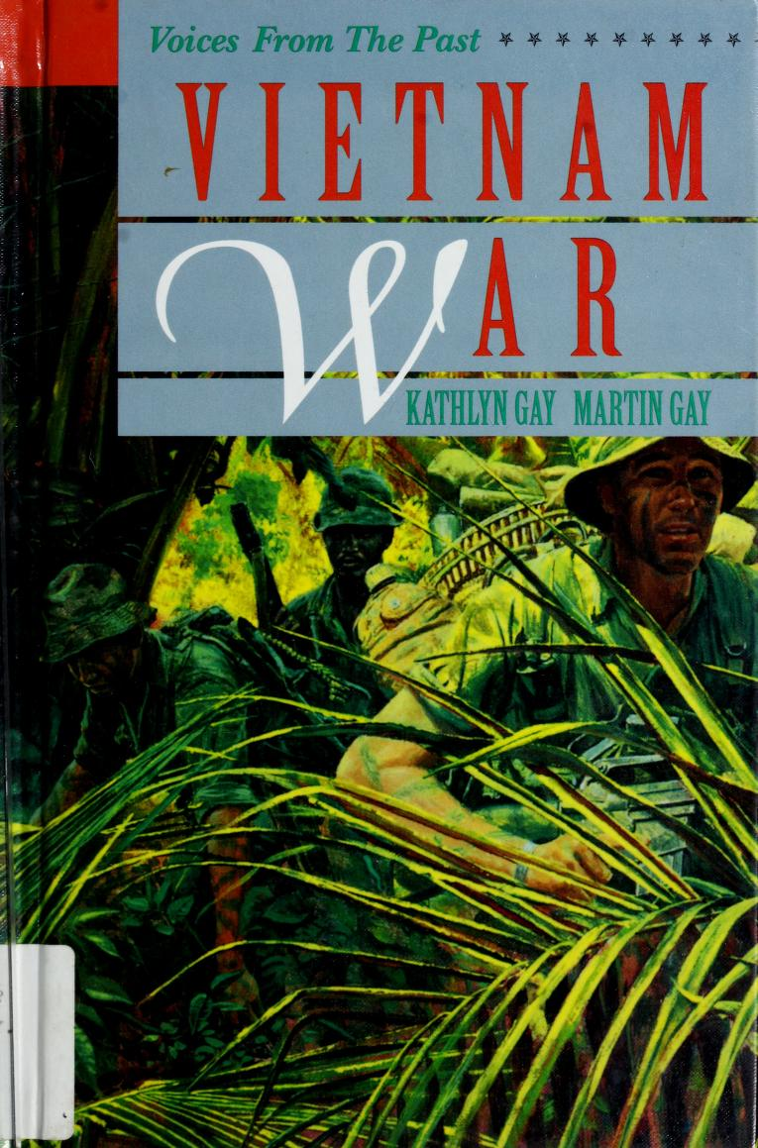
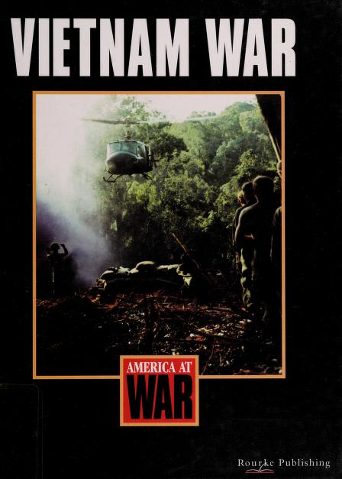
My sources- Books
Justus F. Paul, “The World Is Ours” (Stevens Point Wisconsin: Foundation Press, Inc. ,1994).
Kathlyn Gay and Martin Gay, Vietnam War - Voices From The Past (Brookfield CT: Twenty-First Century Books, 1969).
Kenneth J. Heineman, Campus Wars - The Peace Movement at American State Universities in the Vietnam Era (New York and London: New York University Press, 1993).
Scott Marquette, Vietnam War - America at War (USA: Rourke Publishing LLC, 2003).

